Slide 1
Advanced Digital Signal Processing
Assoc. Prof. Dr.-Ing. Tuan Do-Hong
Department of Telecommunications Engineering
Faculty of Electrical and Electronics Engineering
HoChiMinh City University of Technology
E-mail: do-hong@hcmut.edu.vn

Slide 3
Outline (1)
Chapter 1: Discrete-Time Signal Processing
z-Transform.
Linear Time-Invariant Filters.
Discrete Fourier Transform (DFT).
Chapter 2: Stochastic Processes and Models
Review of Probability and Random Variables.
Stochastic Models.
Stochastic Processes.
Chapter 3: Spectrum Analysis
Spectral Density.
Spectral Representation of Stochastic Process.

Slide 4
Outline (2)
Chapter 4: Eigenanalysis
Properties of Eigenvalues and Eigenvectors.
Chapter 5: Wiener Filters
Minimum Mean-Squared Error.
Wiener-Hopf Equations.
Linearly Constrained Minimum Variance (LCMV) Filter.
Examples: Fixed Weight Beamforming
Chapter 6: Linear Prediction
Forward Linear Prediction.
Backward Linear Prediction.
Levinson-Durbin Algorithm.
Chapter 7: Kalman Filters
Kalman Algorithm.
Applications of Kalman Filter: Tracking Trajectory of Object and System Identification.

Slide 5
Outline (3)
Chapter 8: Linear Adaptive Filtering
Adaptive Filters and Applications.
Method of Steepest Descent.
Least-Mean-Square Algorithm.
Examples of Adaptive Filtering: Adaptive Equalization
and Adaptive Beamforming.
Chapter 9: Estimation Theory
Fundamentals.
Minimum Variance Unbiased Estimators.
Maximum Likelihood Estimation.
Spectral Estimation.
Chapter 10: Multirate Digital Signal Processing

Slide 6
References
[1] Simon Haykin, Adaptive Filter Theory, Prentice Hall,
1996 (3rd Ed.), 2002 (4th Ed.), 2014 (5th Ed.).
[2] Steven M. Kay, Fundamentals of Statistical Signal Processing: Estimation Theory, Prentice Hall, 1993.
[3] Alan V. Oppenheim, Ronald W. Schafer, Discrete-Time Signal Processing, Prentice Hall, 1989.
[4] Athanasios Papoulis, Probability, Random Variables, and Stochastic Processes, McGraw-Hill, 1991 (3rd Ed.), 2001 (4th Ed.).
[5] Dimitris G. Manolakis, Vinay K. Ingle, Stephen M. Kogon, Statistical and Adaptive Signal Processing, Artech House, 2005.

Slide 7
Goal of the Course
Introduction to the theory and algorithms used for the analysis and processing of random signals (stochastic signals) and their applications to communications problems.
Understanding the random signals: via statistical description (theory of probability, random variables and stochastic processes), modeling and the dependence between the samples of one or more discrete-time random signals.
Developing the theoretically methods/practical techniques for processing random signals to achieve a predefined application-dependent objective.
Major applications in communications: signal modeling, spectral estimation, frequency-selective filtering, adaptive filtering, array processing...

Slide 8
Optimum Receiver Design (1)
Communication signal processing is applied in the design and optimization of
transmitter
receiver
baseband parts with respect to user needs and communication channel, which includes
transmitter and receiver radio frequency (RF) parts
antennas
the radio channel itself time-varying.
Therefore, transceivers must be adaptive.

Slide 9
Optimum Receiver Design (2)
Block diagram of a typical digital communication system:

Slide 10
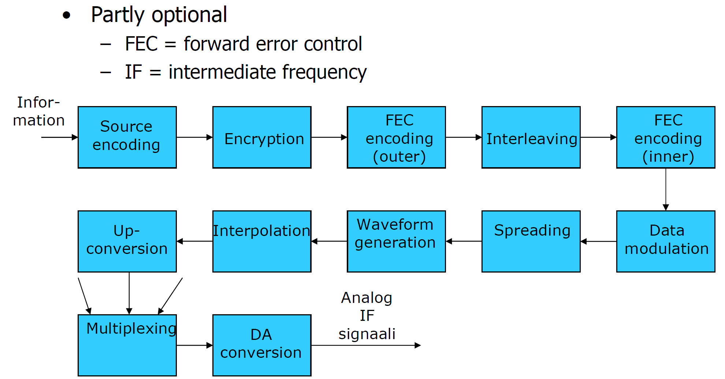
Optimum Receiver Design (3)
A typical transmitter baseband processing chain example:

Slide 11
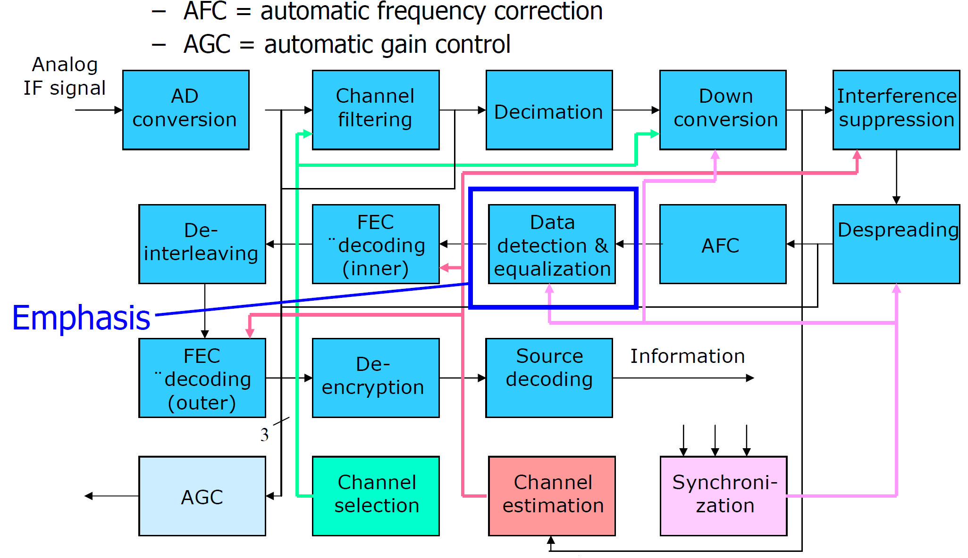
Optimum Receiver Design (4)
A typical receiver baseband processing chain example:

Slide 12
Optimum Receiver Design (5)
The communication receiver design problem can be formulated as an estimation or detection (classification) problem.
→ stochastic signal processing used in detector and equalizer optimization.
We formulate a typical optimization framework herein that is applicable for many scenarios.

Slide 13
Optimum Receiver Design (6)
A simplified transmission system model:
A fully discrete-time (all-digital) baseband model based on sampling and perfect synchronization.
Two channel models used as an illustrative example:
- frequency-selective multi-path channel.
- multiple-input multiple-output (MIMO) multi-antenna channel.

Slide 14
Optimum Receiver Design (8)
Mathematical system model for modulator:
Assume a linear modulation method, e.g.,
– phase shift keying (PSK)
– quadrature amplitude modulation (QAM).
Let the transmitted data symbol be x ∈ Ω where Ω is the modulations symbol alphabet.
– Example, QPSK: Ω = {-1,+1,-j,+j}/√2.

Slide 15
Optimum Receiver Design (9)
Mathematical system model for channel:
Assume that the channel:
causes a complex amplitude scaling hx, where h = |h|e^{jθ} is a complex gain factor with
– amplitude (absolute value) |h|
– phase shift θ
adds an additive noise term η.
Therefore, the received signal sample for discrete time interval n is:
y(n) = h(n)x(n) + η(n).
It allows a time-varying channel gain h(n).

Slide 16
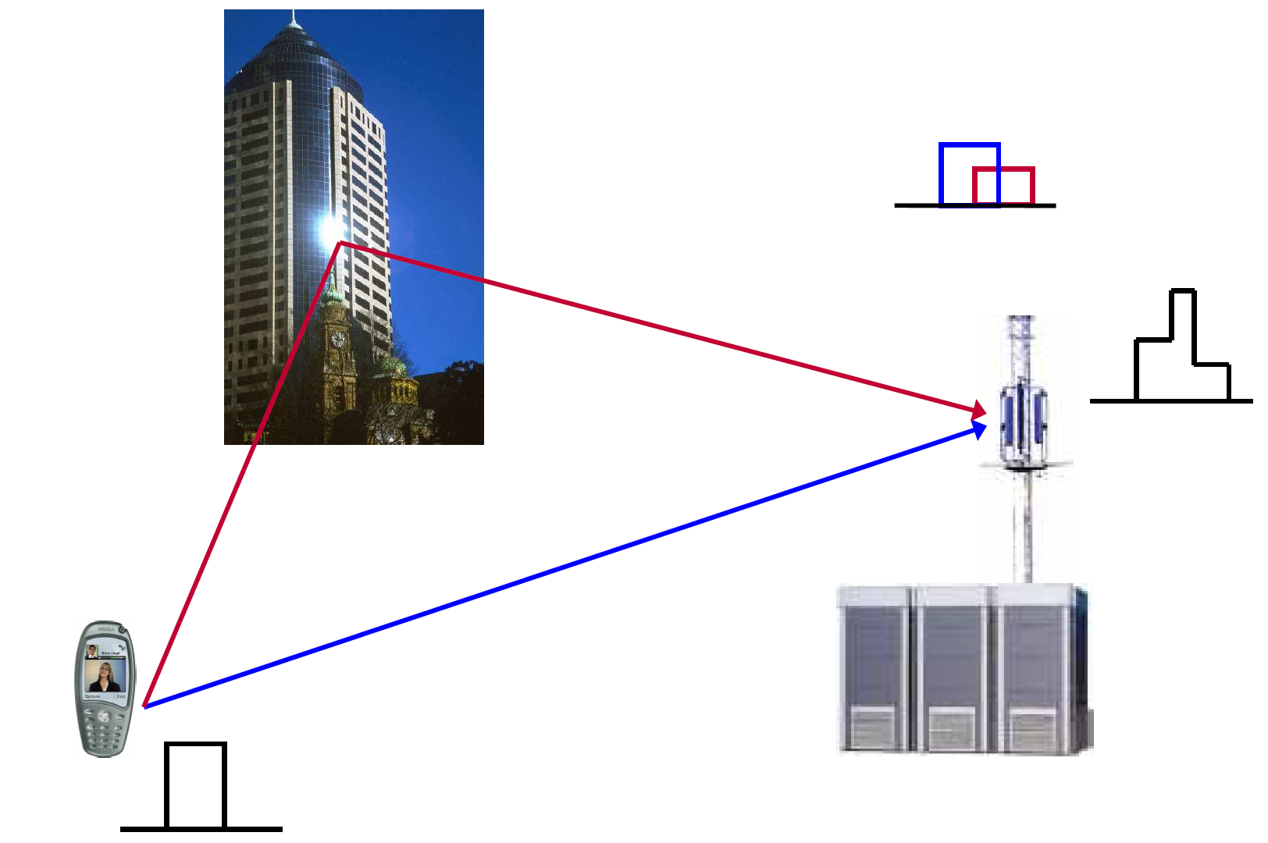
Optimum Receiver Design (10)
Example: Frequency-selective channel

Slide 17
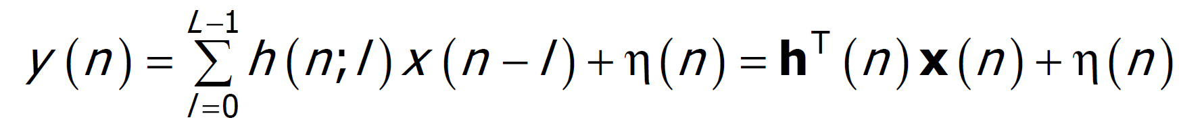
Optimum Receiver Design (11)
Frequency-selective channel: Mathematical model
If the channel is frequency-selective → intersymbol interference (ISI), since multiple consequent transmitted symbols will overlap. Therefore, the received signal sample:
where L is the length of the channel impulse response and

Slide 18
Optimum Receiver Design (12)
Frequency-selective channel: Block model
Processing a block of N_{B} consequent symbols, then the received signal sample vector is
where is the vector of transmitted symbols, and the vector of received symbol-spaced samples is
The channel matrix H can be decomposed as
y = H^{T}x + η
H = [H_{PRE} H_{SS} H_{POST}], where
H_{PRE}, H_{POST} denote the transient parts and
H_{SS} denotes the steady-state part.

Slide 19
Optimum Receiver Design (13)
Frequency-selective channel: Pre-cursor transient channel matrix:

Slide 20
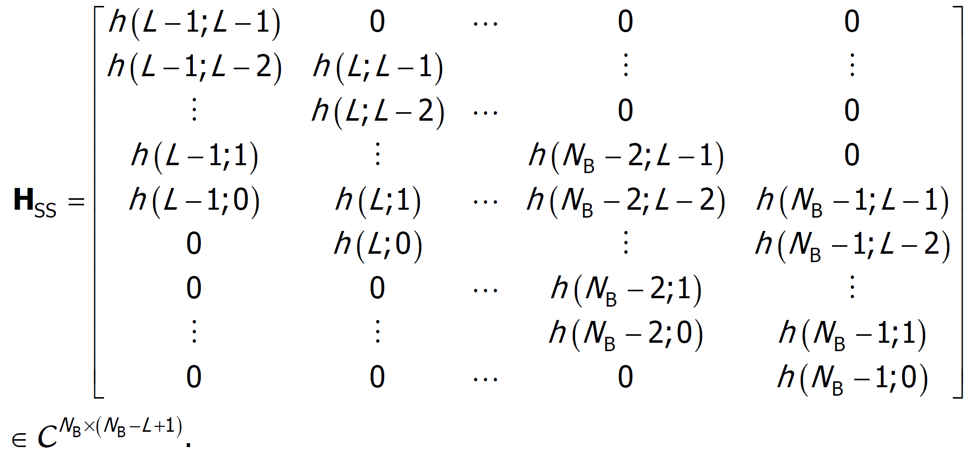
Optimum Receiver Design (14)
Frequency-selective channel: Steady-state channel matrix:

Slide 21
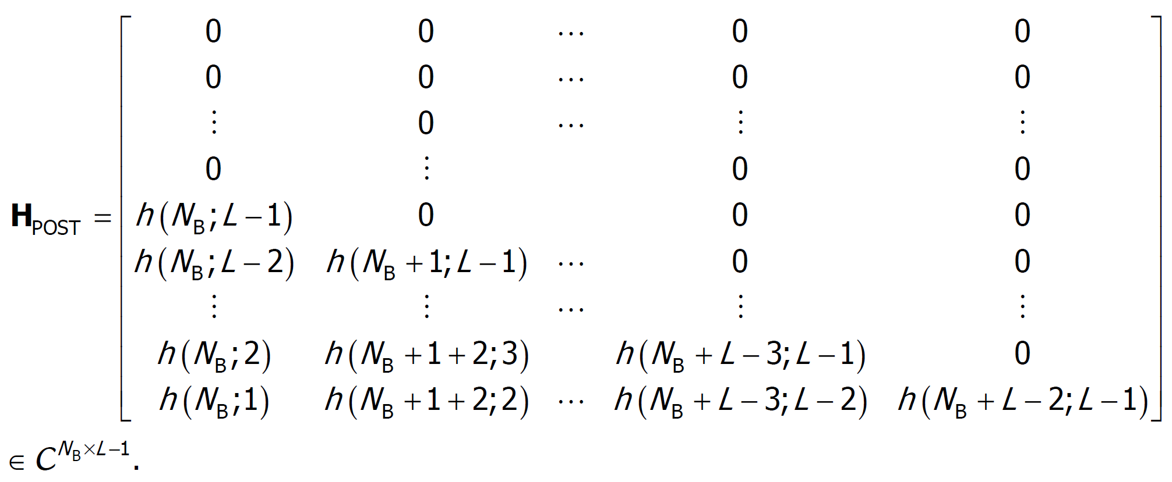
Optimum Receiver Design (15)
Frequency-selective channel: Post-cursor transient channel matrix:

Slide 22
Optimum Receiver Design (16)
Example: Time-invariant channel with N_{B} = 8 and L = 3:

Slide 23
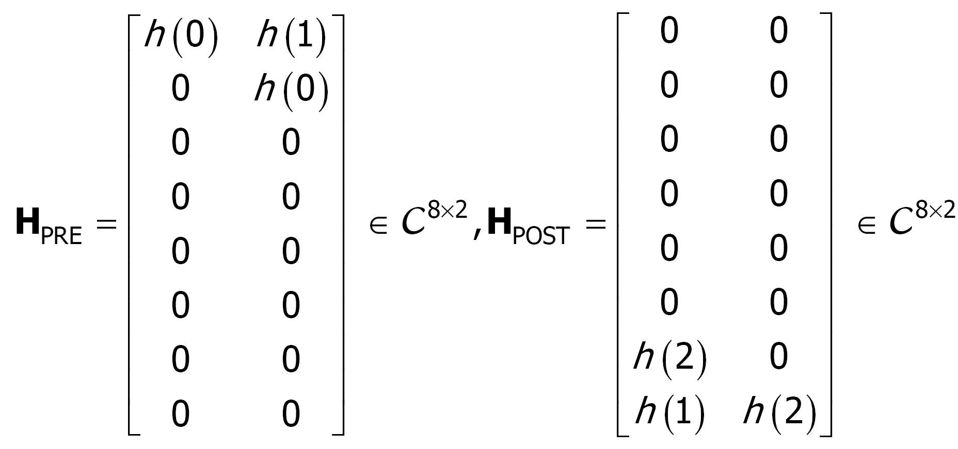
Optimum Receiver Design (17)

Slide 24
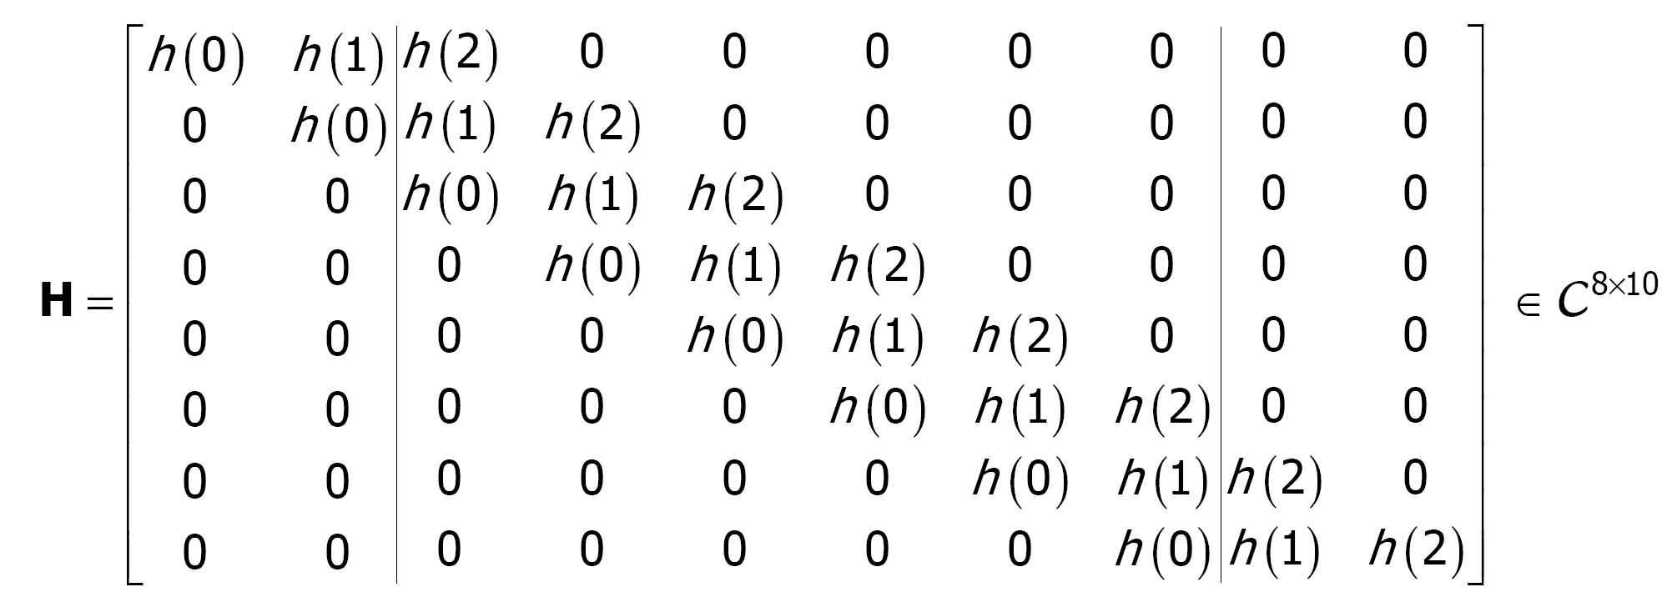
Optimum Receiver Design (18)

Slide 25
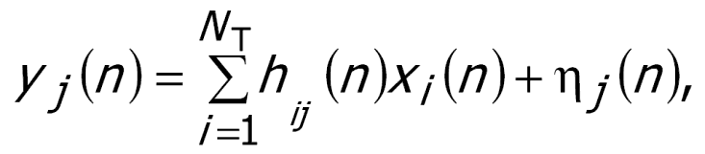
Optimum Receiver Design (19)
Example: Multi-antenna channel
Signal x_{i} (n) is transmitted at
time interval n from antenna i
(i =1, 2,…, N_{T}).
Signal y_{j} (n) is received at time
interval n at antenna j
(j =1, 2,…, N_{R}):
where h_{ij} (n) is the complex
channel gain with

Slide 26
Optimum Receiver Design (20)
Matrix formulation of MIMO channel model:
The signal received at all antennas:
where

Slide 27
Optimum Receiver Design (21)
Receiver design problem:
The receiver must detect/decode the transmitted data.
→ The most likely possible transmitted data symbol should be found.
Due to outer FEC encoding the data bits and symbols are dependent.
→ Joint detection and decoding should is optimal.
– Due to complexity reasons, detection and equalization is
usually separated from decoding.
– Soft output (log-likelihood ratio) information is provided to
the decoder.

Slide 28
Optimum Receiver Design (22)
Received signal as random variable:
The received signal vector y = Hx + η is a random.
– The noise term η is usually modeled as zero mean complex Gaussian with covariance matrix ∑_{η} often also white, i.e., ∑_{η} = σ_{n}²I
– From the receiver perspective, the modulated symbol vector x is a random. Detector sees it usually as uniformly distributed with independent elements (∑_{x} = E_{x}I) over the modulation alphabet Ω, where E_{x} is the symbol energy.
– The channel matrix H is often also a complex Gaussian with possibly some correlation between the elements. A slowly fading channel can also be realistically modeled as constant (known or unknown).
Based on the probability density function (pdf) of received signal vector, we are able to detect the transmitted signal, e.g. using optimum maximum a posteriori (MAP) detector, maximum likelihood (ML) detector.

Slide 29
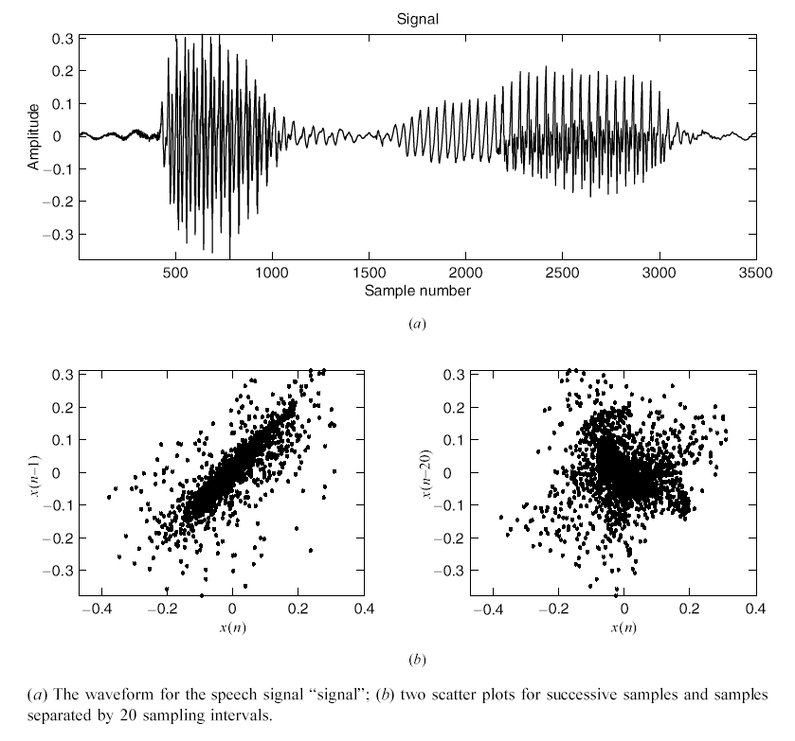
Random Signals vs. Deterministic Signals (1)
Example: Discrete-time random signals (a) and the dependence between the samples (b), [5].

Slide 30
Random Signals vs. Deterministic Signals (2)
A random signal is not (precisely) predictable, it is not able to find a mathematical formula that provides its values as a function of time.
A white noise is random signal when every sample is independent of all other samples. Such a signal is completely unpredictable.
When signal samples are dependent and can be predicted precisely, it is deterministic signal.

Slide 31
Techniques for Processing Random Signals
Random signal analysis (signal modeling, spectral estimation): Primary goal is to extract useful information for understanding and classifying the signals.
Typical applications: Detection of useful information from receiving signals, system modeling/identification, detection and classification of radar and sonar targets, speech recognition, signal representation for data compression…
Random signal filtering (frequency-selective filtering, adaptive filtering, array processing): Main objective is to improve the quality of a signal according to a criterion of performance.
Typical applications: Noise and interference cancellation, echo cancellation, channel equalization, active noise control…

Slide 32
Random Signal Analysis (1)
The objective of signal analysis is the development of quantitative techniques to study the properties of a signal and the differences and similarities between two or more signals from the same or different sources.
The prominent tool in signal analysis is spectral estimation, which is a generic term for a multitude of techniques used to estimate the distribution of energy or power of a signal from a set of observations.
The major areas of random signal analysis are:
Statistical analysis of signal amplitude (i.e., the sample values);
Analysis and modeling of the correlation among the samples of an individual signal;
Joint signal analysis (i.e., simultaneous analysis of two signals in order to investigate their interaction or interrelationships).

Slide 33
Random Signal Analysis (2)

Slide 34
Random Signal Analysis (3)
Amplitude distribution: The range of values taken by the samples of a signal and how often the signal assumes these values together determine the signal variability. The signal variability can be quantified by the histogram (probability density) of the signal samples, which shows the percentage of the signal amplitude values within a certain range. The numerical description of signal variability, which depends only on the value of the signal samples and not on their ordering, involves quantities such as mean value, median, variance, and dynamic range.

Slide 35
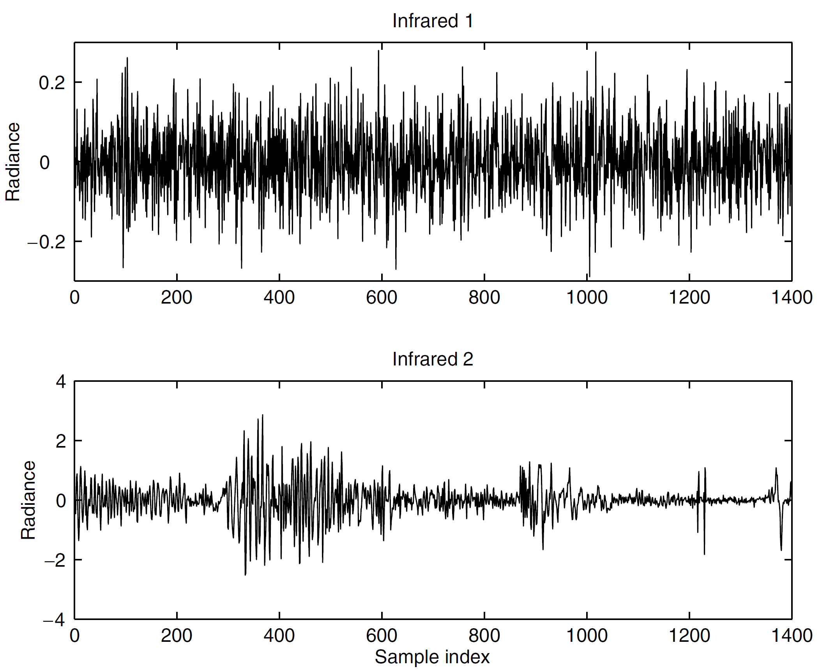
Random Signal Analysis (4)
Example:
Two random signals (infrared 1 and infrared 2)

Slide 36
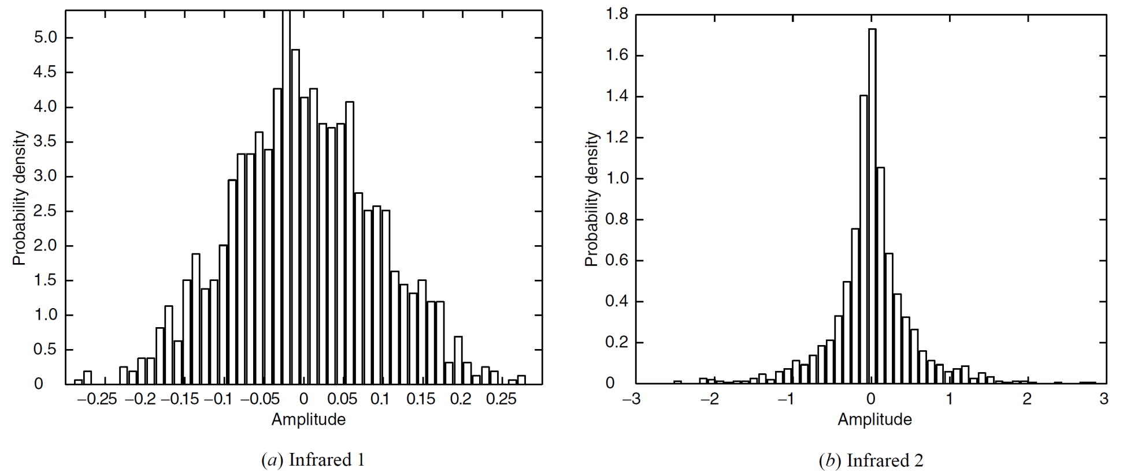
Random Signal Analysis (5)
Histograms for infrared 1 and infrared 2:

Slide 37
Random Signal Analysis (6)
Correlation and spectral analysis: The scatter plot (see Slide 7) can be used to illustrate the existence of correlation, however, to obtain quantitative information about the correlation structure of a time series signal x(n) with zero mean value, we use the empirical normalized autocorrelation sequence:
The spectral density function shows the distribution of signal power or energy as a function of frequency. The autocorrelation and the spectral density of a signal form a Fourier transform pair and hence contain the same information.

Slide 38
Random Signal Analysis (7)
Joint signal analysis. In many applications, we are interested in the relationship between two different random signals. There are two cases of interest:
In the first case, the two signals are of the same or similar nature, and we want to ascertain and describe the similarity or interaction between them.
In the second case, we may have reason to believe that there is a causal relationship between the two signals. For example, one signal may be the input to a system and the other signal the output. The task in this case is to find an accurate description of the system, that is, a description that allows accurate estimation of future values of the output from the input. This process is known as system modeling or system identification and has many practical applications (including understanding the operation of a system in order to improve the design of new systems or to achieve better control of existing systems).

Slide 39
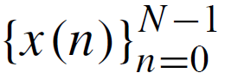
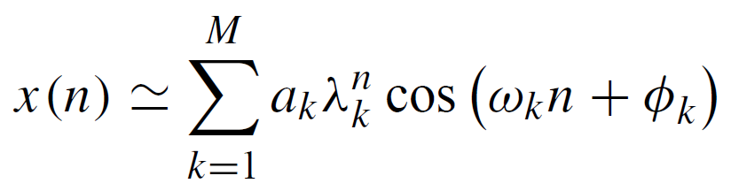
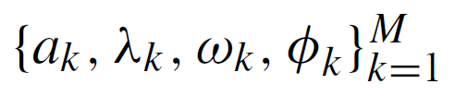
Random Signal Modeling (1)
In many theoretical and practical applications, we are interested in generating random signals with certain properties or obtaining an efficient representation of real-world random signals that captures a desired set of their characteristics (e.g., correlation or spectral features) in the best possible way. We use the term model to refer to a mathematical description that provides an efficient representation of the “essential” properties of a signal.
Example: A finite segment of any signal can be approximated by a linear combination of constant (λ_{k} = 1) or exponentially fading
(0 < λ_{k} < 1) sinusoids:
where are the model parameters.

Slide 40
Random Signal Modeling (2)
From a practical viewpoint, we are most interested in parametric models, which assume a given functional form completely specified by a finite number of parameters. In contrast, nonparametric models do not put any restriction on the functional form or the number of model parameters.
In practice, signal modeling involves the following steps:
Selection of an appropriate model.
Selection of the “right” number of parameters.
Fitting of the model to the actual data.
Model testing to see if the model satisfies the user requirements for the particular application.

Slide 41
Random Signal Modeling (3)
If we can develop a successful parametric model for the behavior of a signal, then we can use the model for various applications:
To achieve a better understanding of the physical mechanism generating the signal.
To track changes in the source of the signal and help identify their cause.
To synthesize artificial signals similar to the natural ones (e.g., speech, infrared backgrounds, natural scenes, data network traffic).
To extract parameters for pattern recognition applications (e.g., speech and character recognition).
To get an efficient representation of signals for data compression (e.g., speech, audio, and video coding).
To forecast future signal behavior.

Slide 42
Adaptive Filtering (1)
Conventional frequency-selective digital filters with fixed coefficients are designed to have a given frequency response chosen to alter the spectrum of the input signal in a desired manner. Their key features are as follows:
The filters are linear and time-invariant.
The design procedure uses the desired passband, transition bands, passband ripple, and stopband attenuation. We do not need to know the sample values of the signals to be processed.
Since the filters are frequency-selective, they work best when the various components of the input signal occupy non-overlapping frequency bands. For example, it is easy to separate a signal and additive noise when their spectra do not overlap.
The filter coefficients are chosen during the design phase and are held constant during the normal operation of the filter.

Slide 43
Adaptive Filtering (2)
However, there are many practical application problems that cannot be successfully solved by using fixed digital filters because either we do not have sufficient information to design a digital filter with fixed coefficients or the design criteria change during the normal operation of the filter.
Most of these applications can be successfully solved by using special “smart” filters known collectively as adaptive filters. The distinguishing feature of adaptive filters is that they can modify their response to improve performance during operation without any intervention from the user.

Slide 44
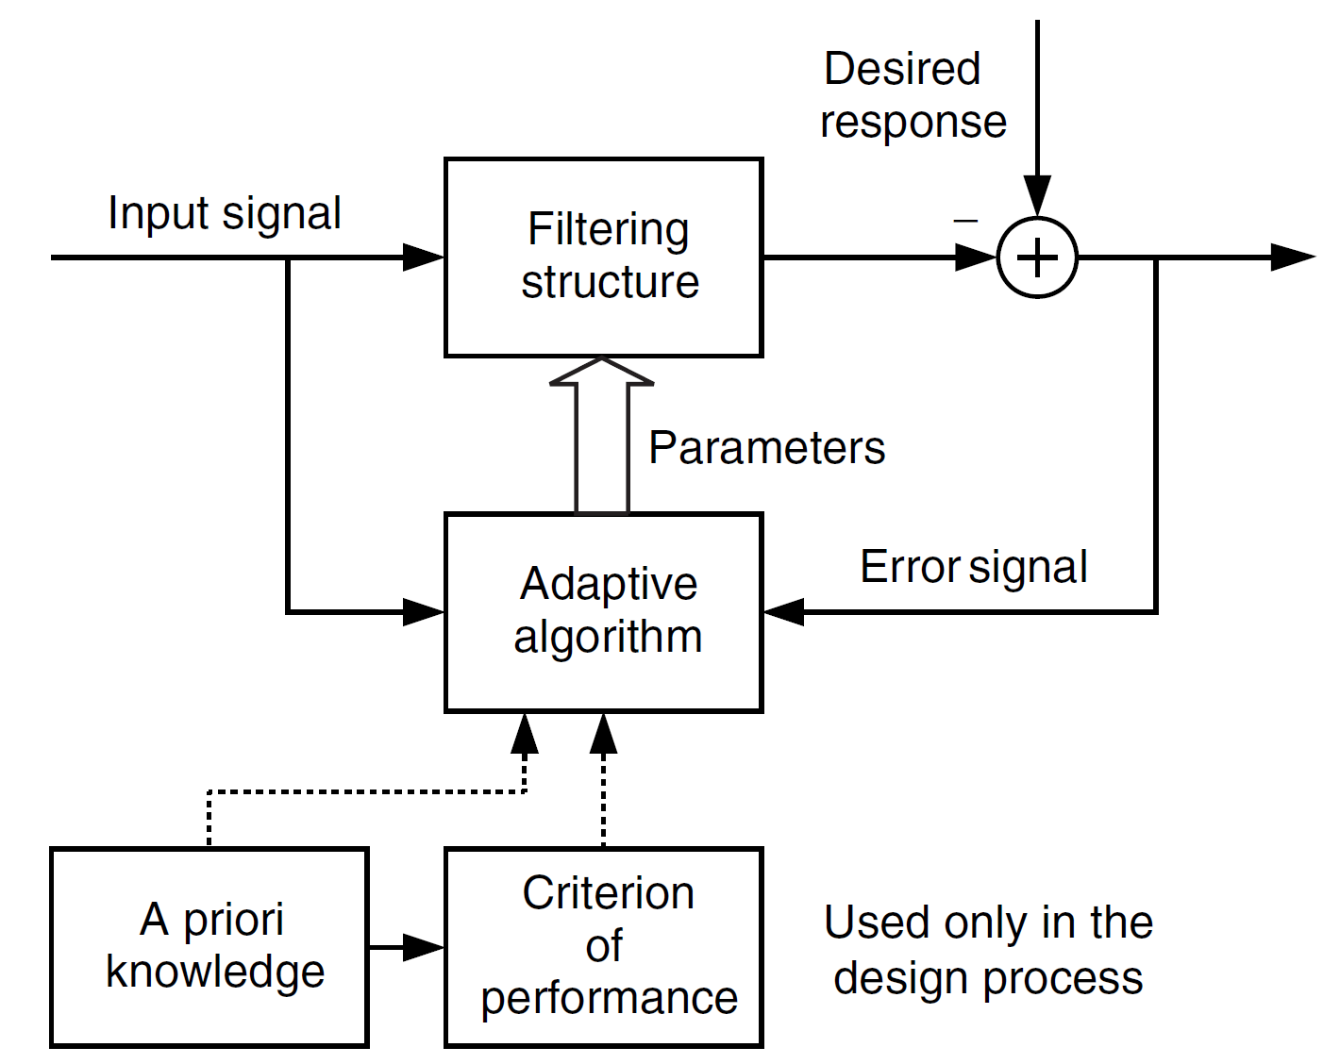
Adaptive Filtering (3)
Basis elements of a general adaptive filters:

Slide 45
Adaptive Filtering (4)
Filtering structure. This module forms the output of the filter using measurements of the input signal(s). The filtering structure is linear if the output is obtained as a linear combination of the input measurements; otherwise, it is said to be nonlinear. The structure is fixed by the designer, and its parameters are adjusted by the adaptive algorithm.
Criterion of performance (COP). The output of the adaptive filter and the desired response (when available) are processed by the COP module to assess its quality with respect to the requirements of the particular application.
Adaptive algorithm. The adaptive algorithm uses the value of the criterion of performance, or some function of it, and the measurements of the input and desired response (when available) to decide how to modify the parameters of the filter to improve its performance.

Slide 46
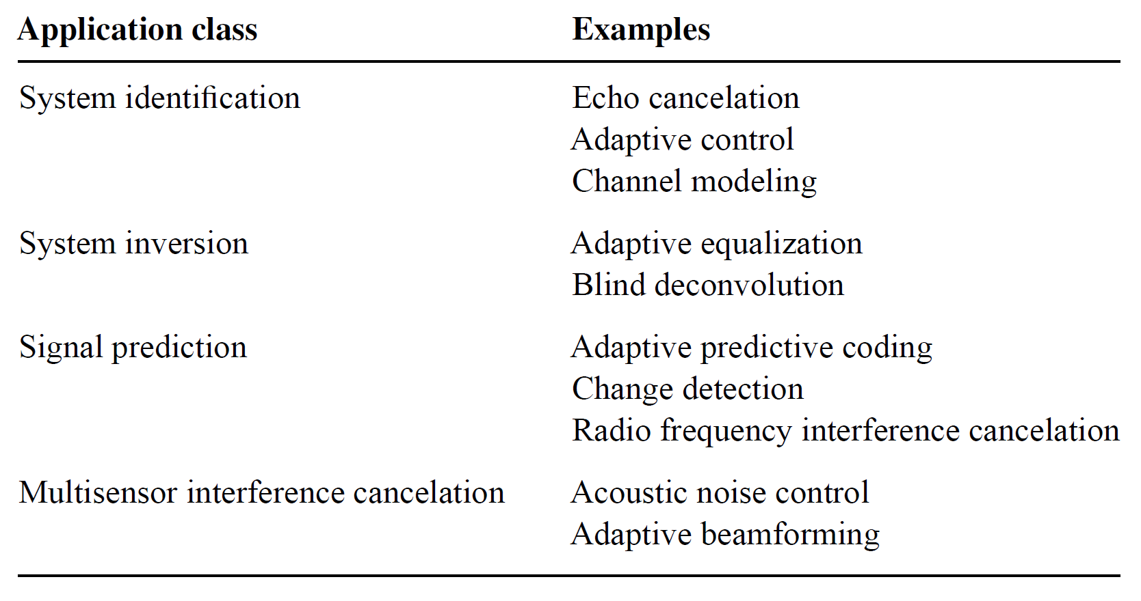
Adaptive Filtering (5)
Typical application problems that can be effectively solved by using an adaptive filter:

Slide 47
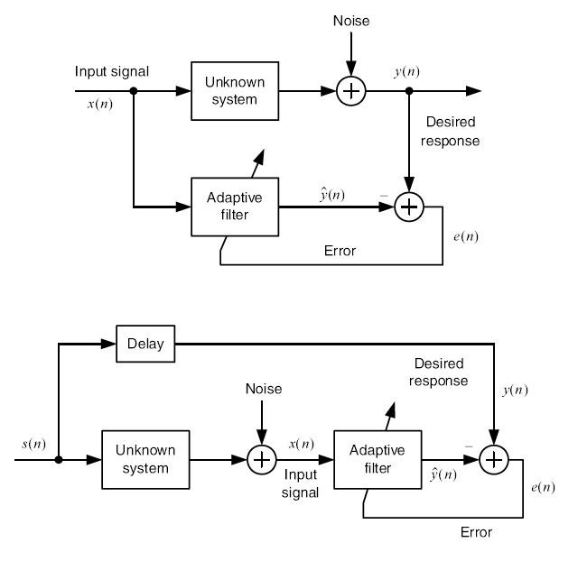
Adaptive Filtering (6)
System identification [5]:
System inversion [5]:

Slide 48
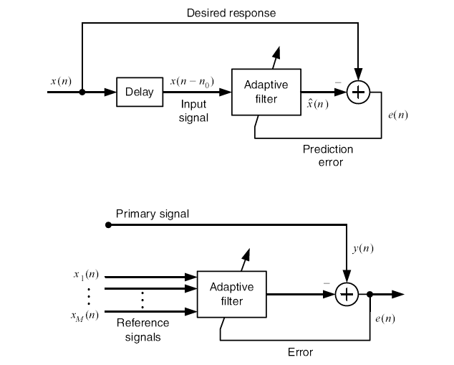
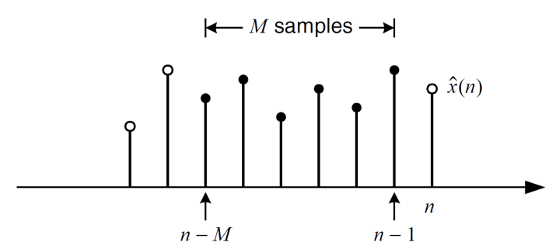
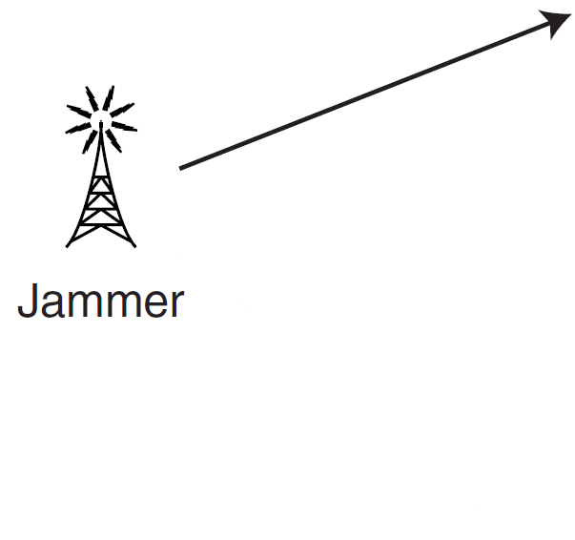
Adaptive Filtering (7)
Signal prediction [5]:
Interference cancellation [5]:

Slide 49
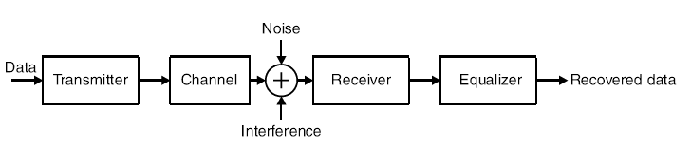
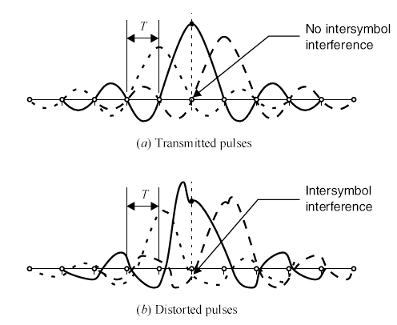
Adaptive Filtering (8)
Simple model of a digital communications system with channel equalization [5]:
Pulse trains: (a) without intersymbol
interference (ISI) and (b) with ISI.
ISI distortion: The tails of adjacent
pulses interfere the current pulse and
can lead to an incorrect decision.
The equalizer can compensate for
the ISI distortion.

Slide 50
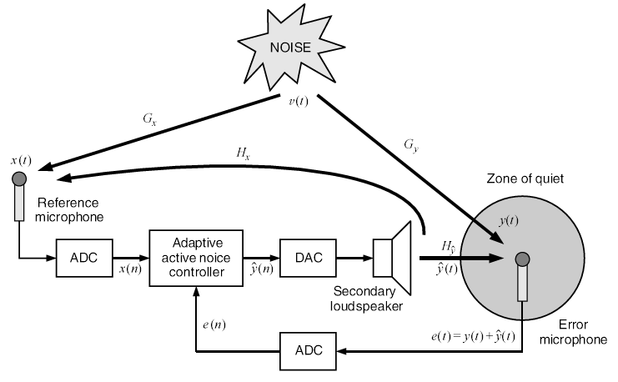
Adaptive Filtering (9)
Block diagram of the basic components of an active noise control system [5]:

Slide 51
Array Processing (1)
Array processing deals with techniques for the analysis and processing of signals collected by a group of sensors (sensor array).
The collection of sensors makes up the array, and the manner in which the signals from the sensors are combined and handled constitutes the processing.
The type of processing is dictated by the needs of the particular application. Array processing has found widespread application in a large number of areas, including radar, sonar, communications, seismology, geophysical prospecting for oil and natural gas, diagnostic ultrasound, and multi-channel audio systems.

Slide 52

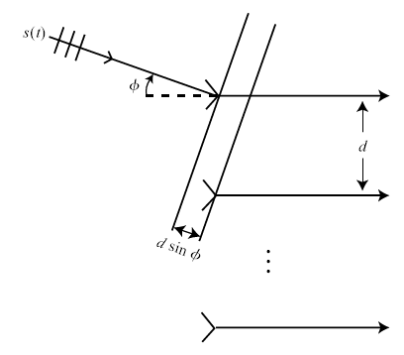
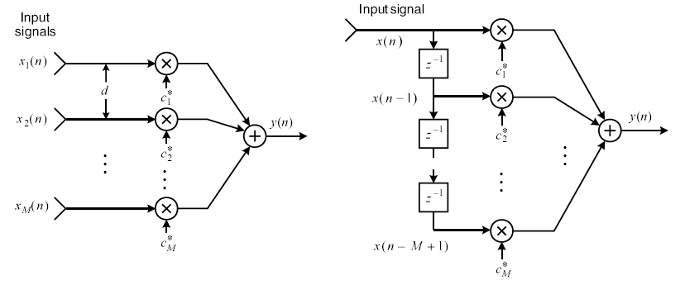
Array Processing (2)
Spatial filtering (Beamforming) [5]:

Slide 53
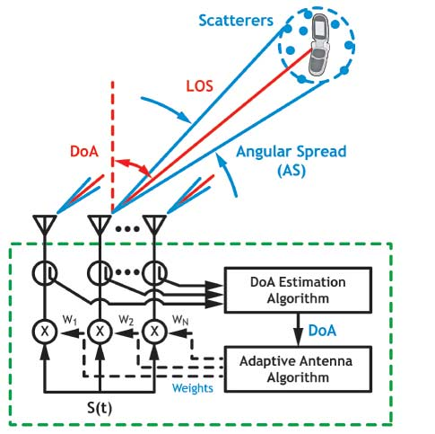
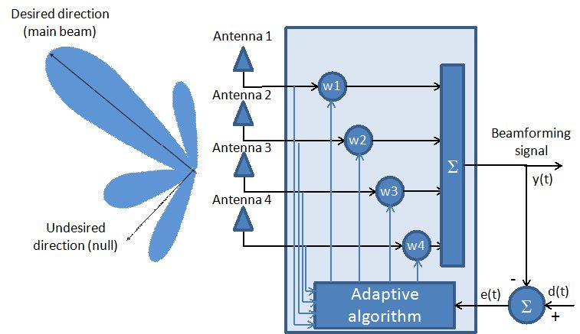
Array Processing (3)
Beamforming based on
Adaptive algorithms (e.g. at Rx)
Beamforming based on
DoA estimation (e.g. at Tx)

Slide 54
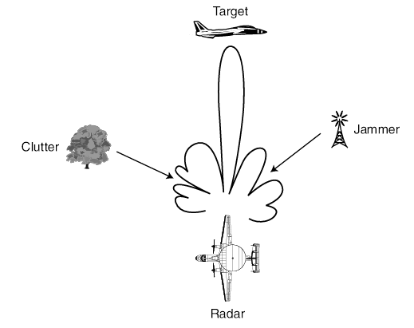
Array Processing (4)
Example of (adaptive) beamforming with an airborne for interference mitigation [5]:

Slide 55
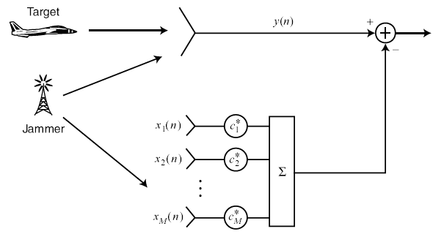
Array Processing (5)
(Adaptive) Sidelobe canceler [5]:

Slide 56
Chapter 1: Discrete-Time Signal Processing
z-Transform.
Linear Time-Invariant Filters.
Discrete Fourier Transform (DFT).

Slide 57
1. Z-transform (1)
Discrete-time signals → signals described as a time series, consisting of sequence of uniformly spaced samples whose varying amplitudes carry the useful information content of the signal.
Consider time series (sequence) {u(n)} or u(n) denoted by samples:
u(n), u(n-1), u(n-2),…, n: discrete time.
Z-transform of u(n):
z: complex variable.
z-transform pair: u(n) ↔ U(z).
Region of convergence (ROC): set of values of z for which U(z) is uniformly convergent.
(1.1)

Slide 58
1. Z-transform (2)
Properties:
Linear transform (superposition):
ROC of (1.2): intersection of ROC of U₁(z) and ROC of U₂(z).
Time-shifting:
n₀: integer.
ROC of (1.3): same as ROC of U(z).
Special case:
z⁻¹: unit-delay element.
Convolution theorem:
ROC of (1.4): intersection of ROC of U₁(z) and ROC of U₂(z).
(1.2)
(1.3)
(1.4)

Slide 59
1. Linear Time-Invariant (LTI) Filters (1)
Definition:
Impulse response h(n):
For arbitrary input v(n): convolution sum
LTI
Filter:
Linearity,
Time-invariant
v(n)
u(n)
LTI
Filter
h(n)
u(n)=h(n)
t=0
(1.5)

Slide 60
1. LTI Filters (2)
Transfer function:
Applying z-transform to both side of (1.5)
H(z): transfer function of the filter
When input sequence v(n) and output sequence u(n) are related by difference equation of order N:
a_{j}, b_{j}: constant coefficients. Applying z-transform, obtaining:
(1.6)
(1.7)
(1.8)
(1.9)

Slide 61
1. LTI Filters (3)
From (1.9), two distinct types of LTI filters:
Finite-duration impulse response (FIR) filters: d_{k}=0 for all k.
→ all-zero filter, h(n) has finite duration.
Infinite-duration impulse response (IIR) filters: H(z) has at least one non-zero pole, h(n) has infinite duration. When c_{k}=0 for all k → all-pole filter.
See examples of FIR and IIR filters in next two slides.

Slide 62
1. LTI Filters (4)
v(n)
v(n-1)
v(n-2)
v(n-M+1)
v(n-M)
z⁻¹
z⁻¹
…
z⁻¹
a₁
a₂
…
a_{M-1}
a_{M}
u(n)
+
+
…
+
+
FIR filter

Slide 63
1. LTI Filters (5)
v(n)
+
u(n)
z⁻¹
+
a₁
u(n-1)
z⁻¹
+
a₂
u(n-2)
.
.
.
+
a_{M-1}
u(n-M+1)
z⁻¹
IIR filter
a_{M}
u(n-M)

Slide 64
1. LTI Filters (6)
Causality and stability:
LTI filter is causal if:
LTI filter is stable if output sequence is bounded for all bounded input sequences. From (1.5), necessary and sufficient condition:
(1.10)
(1.11)
Im
Unit circle
A causal LTI filter is stable if and only if all of the poles of the filter’s transfer function lie inside the unit circle in the z-plane
(See more in [3])
Re
Region of
stability
z-plane

Slide 65
1. Discrete Fourier Transform (DFT) (1)
Fourier transform of a sequence u(n) is obtained from z-transform by setting z=exp(j2πf), f: real frequency variable.
When u(n) has a finite duration, its Fourier representation → discrete Fourier transform (DFT).
For numerical computation of DFT → efficient fast Fourier transform (FFT).
u(n): finite-duration sequence of length N, DFT of u(n):
Inverse DFT (IDFT) of U(k):
u(n), U(k): same length N → “N-point DFT”
(1.12)
(1.13)

Slide 66
Chapter 2: Stochastic Processes and Models
Review of Probability and Random Variables.
Review of Stochastic Processes and Stochastic Models.

Slide 67
2. Review of Probability and Random Variables
Axioms of Probability.
Repeated Trials.
Concepts of Random Variables.
Functions of Random Variables.
Moments and Conditional Statistics.
Sequences of Random Variables.

Slide 68
2. Review of Probability Theory: Basics (1)
Probability theory deals with the study of random phenomena, which under repeated experiments yield different outcomes that have certain underlying patterns about them. The notion of an experiment assumes a set of repeatable conditions that allow any number of identical repetitions. When an experiment is performed under these conditions, certain elementary events occur in different but completely uncertain ways. We can assign nonnegative number as the probability of the event in various ways:
Laplace’s Classical Definition: The Probability of an event A is defined a-priori without actual experimentation as
provided all these outcomes are equally likely.

Slide 69
2. Review of Probability Theory: Basics (2)
Relative Frequency Definition: The probability of an event A is defined as
where n_{A} is the number of occurrences of A and n is the total number of
trials.
The axiomatic approach to probability, due to Kolmogorov, developed
through a set of axioms (below) is generally recognized as superior to the
above definitions, as it provides a solid foundation for complicated
applications.

Slide 70
2. Review of Probability Theory: Basics (3)
The totality of all known a priori, constitutes a set Ω, the set of all experimental outcomes.
Ω has subsets Recall that if A is a subset of Ω, then implies From A and B, we can generate other related subsets
and

Slide 71
2. Review of Probability Theory: Basics (4)
A
B
A
B
A
If the empty set, then A and B are said to be mutually exclusive (M.E).
A partition of Ω is a collection of mutually exclusive subsets of Ω such that their union is Ω.
A
B

Slide 72
2. Review of Probability Theory: Basics (5)
De-Morgan’s Laws:
A
B
A
B
A
B
A
B
Often it is meaningful to talk about at least some of the subsets of Ω as
events, for which we must have mechanism to compute their probabilities.
Example: Consider the experiment where two coins are simultaneously tossed. The various elementary events are

Slide 73
2. Review of Probability Theory: Basics (6)
and
The subset is the same as “Head has occurred at least once” and qualifies as an event.
Suppose two subsets A and B are both events, then consider
“Does an outcome belong to A or B ”
“Does an outcome belong to A and B ”
“Does an outcome fall outside A”?

Slide 74
2. Review of Probability Theory: Basics (7)
Thus the sets etc., also qualify as events. We shall
formalize this using the notion of a Field.
Field: A collection of subsets of a nonempty set Ω forms a field F if
Using (i) - (iii), it is easy to show that etc., also belong to F.
For example, from (ii) we have and using (iii) this gives
applying (ii) again we get where we
have used De Morgan’s theorem in slide 22.

Slide 75
2. Review of Probability Theory: Basics (8)
Axioms of Probability
For any event A, we assign a number P(A), called the probability of the event A. This number satisfies the following three conditions that act the axioms of probability.
(Note that (iii) states that if A and B are mutually exclusive (M.E.) events)

Slide 76
2. Review of Probability Theory: Basics (9)
The following conclusions follow from these axioms:
a.
b.
c. Suppose A and B are not mutually exclusive (M.E.)?
Conditional Probability and Independence
In N independent trials, suppose N_{A}, N_{B}, N_{AB} denote the number of times events A, B and AB occur respectively, for large N
Among the N_{A} occurrences of A, only N_{AB} of them are also found among the N_{B} occurrences of B. Thus the ratio

Slide 77
2. Review of Probability Theory: Basics (10)
is a measure of “the event A given that B has already occurred”. We denote this conditional probability by
P(A|B) = Probability of “the event A given that B has occurred”.
We define
provided As we show below, the above definition satisfies all probability axioms discussed earlier.
Independence: A and B are said to be independent events, if
Then
Thus if A and B are independent, the event that B has occurred does not shed any more light into the event A. It makes no difference to A whether B has occurred or not.

Slide 78
2. Review of Probability Theory: Basics (11)
Let
a union of n independent events. Then by De-Morgan’s law
and using their independence
Thus for any A as in (*)
a useful result.
(*)
PILLAI

Slide 79
2. Review of Probability Theory: Basics (12)
Bayes’ theorem:
Although simple enough, Bayes’ theorem has an interesting interpretation: P(A) represents the a-priori probability of the event A. Suppose B has occurred, and assume that A and B are not independent. How can this new information be used to update our knowledge about A? Bayes’ rule above take into account the new information (“B has occurred”) and gives out the a-posteriori probability of A given B.
We can also view the event B as new knowledge obtained from a fresh experiment. We know something about A as P(A). The new information is available in terms of B. The new information should be used to improve our knowledge/understanding of A. Bayes’ theorem gives the exact mechanism for incorporating such new information.

Slide 80
2. Review of Probability Theory: Basics (13)
Let are pair wise disjoint we have
A more general version of Bayes’ theorem

Slide 81
2. Review of Probability Theory: Basics (14)
Example: Three switches connected in parallel operate independently. Each switch remains closed with probability p. (a) Find the probability of receiving an input signal at the output. (b) Find the probability that switch S₁ is open given that an input signal is received at the output.
Solution:
a. Let A_{i} = “Switch S_{i} is closed”. Then
Since switches operate independently, we have
Input
Output

Slide 82
2. Review of Probability Theory: Basics (15)
Let R = “input signal is received at the output”. For the event R to occur either switch 1 or switch 2 or switch 3 must remain closed, i.e.,
Using results in slide 38,
b. We need From Bayes’ theorem
Because of the symmetry of the switches, we also have

Slide 83
2. Review of Probability Theory: Repeated Trials (1)
Consider two independent experiments with associated probability models (Ω₁, F₁, P₁) and (Ω₂, F₂, P₂). Let ξ∈Ω₁, η∈Ω₂ represent elementary events. A joint performance of the two experiments produces an elementary events ω = (ξ, η). How to characterize an appropriate probability to this “combined event” ?
Consider the Cartesian product space Ω = Ω₁× Ω₂ generated from Ω₁ and Ω₂ such that if ξ ∈ Ω₁ and η ∈ Ω₂ , then every ω in Ω is an ordered pair of the form ω = (ξ, η). To arrive at a probability model we need to define the combined trio (Ω, F, P).
Suppose A∈F₁ and B ∈ F₂. Then A × B is the set of all pairs (ξ, η), where ξ ∈ A and η ∈ B. Any such subset of Ω appears to be a legitimate event for the combined experiment. Let F denote the field composed of all such subsets A × B together with their unions and compliments. In this combined experiment, the probabilities of the events A × Ω₂ and Ω₁ × B are such that

Slide 84
2. Review of Probability Theory: Repeated Trials (2)
Moreover, the events A × Ω₂ and Ω₁ × B are independent for any A ∈ F₁ and
B ∈ F₂ . Since
then
for all A ∈ F₁ and B ∈ F₂ . This equation extends to a unique probability
measure on the sets in F and defines the combined trio (Ω, F, P).
Generalization: Given n experiments and their associated
let
represent their Cartesian product whose elementary events are the ordered
n-tuples where Events in this combined space are of
the form
where

Slide 85
2. Review of Probability Theory: Repeated Trials (3)
If all these n experiments are independent, and P(A_{i}) is the probability of
the event A_{i} in F_{i} then as before
Example: An event A has probability p of occurring in a single trial. Find the probability that A occurs exactly k times, k ≤ n in n trials.
Solution: Let (Ω, F, P) be the probability model for a single trial. The outcome of n experiments is an n-tuple
where every and . The event A occurs at trial # i , if Suppose A occurs exactly k times in ω. Then k of the belong to A, say and the remaining n-k are contained in its compliment in

Slide 86
2. Review of Probability Theory: Repeated Trials (4)
Using independence, the probability of occurrence of such an ω is given by
However the k occurrences of A can occur in any particular location inside
ω. Let represent all such events in which A occurs exactly
k times. Then
But, all these ω_{i} s are mutually exclusive, and equiprobable. Thus

Slide 87
2. Review of Probability Theory: Repeated Trials (5)
Recall that, starting with n possible choices, the first object can be chosen
n different ways, and for every such choice the second one in (n-1) ways, …
and the kth one (n-k+1) ways, and this gives the total choices for k objects
out of n to be n(n-k)…(n-k+1). But, this includes the k! choices among the
k objects that are indistinguishable for identical objects. As a result
represents the number of combinations, or choices of n identical objects
taken k at a time. Thus, we obtain Bernoulli formula

Slide 88
2. Review of Probability Theory: Repeated Trials (6)
Independent repeated experiments of this nature, where the outcome is
either a “success” or a “failure” are characterized as Bernoulli trials, and the probability of k successes in n trials is given by Bernoulli formula, where p represents the probability of “success”
in any one trial.
Bernoulli trial: consists of repeated independent and identical
experiments each of which has only two outcomes A or with
and The probability of exactly k occurrences of A in n such trials
is given by Bernoulli formula. Let
Since the number of occurrences of A in n trials must be an integer
k = 0, 1, 2,…, n, either X₀ or X₁ or X₂ or … or X_{n} must occur in such an experiment. Thus

Slide 89
2. Review of Probability Theory: Repeated Trials (7)
But X_{i}, X_{j} are mutually exclusive. Thus
For a given n and p what is the most likely value of k ?
From Figure, the most probable value of k is that number which maximizes
P_{n}(k) in Bernoulli formula. To obtain this value, consider the ratio

Slide 90
2. Review of Probability Theory: Repeated Trials (8)
Thus, P_{n}(k) ≥ P_{n}(k-1), if k(1-p) ≤ (n-k+1)p or k ≤ (n+1)p . Thus P_{n}(k) as a
function of k increases until
if it is an integer, or the largest integer k_{max} less than (n+1)p, it represents
the most likely number of successes (or heads) in n trials.
Example: Parity check coding.

Slide 91
2. Review of Probability Theory: Repeated Trials (9)
Approximate evaluation of , [4], with :
where G(x) is expressed in terms of the error function:
(see the table next slide)
If not only but also then
Example: see Example 3-16, p. 52, [4].

Slide 92
2. Review of Probability Theory: Repeated Trials (10)

Slide 93
2. Review of Probability Theory: Repeated Trials (11)
Example : A fair coin is tossed 5,000 times. Find the probability that the number of heads is between 2,475 to 2,525.
Solution: We need Here n is large so that we can use the normal approximation. In this case p = 0.5 so that and Since and the approximation is valid for and Thus
Here
Since from Fig. 5.1(b), the above probability is given by

Slide 94
2. Review of Probability Theory: Repeated Trials (12)
Poisson theorem: if np is of order of one, np → a, p → 0, n → ∞, then
Therefore,
Example: see Example 3-21, p. 56, [4].

Slide 95
2. Review of Probability Theory: Repeated Trials (13)
The Poisson Approximation
As we have mentioned earlier, for large n, the Gaussian approximation of a binomial r.v is valid only if p is fixed, i.e., only if and What if np is small, or if it does not increase with n?
Obviously that is the case if, for example, as such that is a fixed number.

Slide 96
2. Review of Probability Theory: Repeated Trials (14)
Many random phenomena in nature in fact follow this pattern: Total number of calls on a telephone line, claims in an insurance company etc. tend to follow this type of behavior.
Consider random arrivals such as telephone calls over a line. Let n represent the total number of calls in the interval From our experience, as we have so that we may assume
Consider a small interval of duration Δ as in Figure below. If there is only a single call coming in, the probability p of that single call occurring in that interval must depend on its relative size with respect to T.

Slide 97
2. Review of Probability Theory: Repeated Trials (15)
Hence we may assume Note that as However in this case
is a constant, and the normal approximation is invalid here.
Suppose the interval Δ is of interest to us. A call inside that interval is a “success” (H), whereas one outside is a “failure” (T ). This is equivalent to the coin tossing situation, and hence the probability of obtaining k calls (in any order) in an interval of duration Δ is given by the binomial p.m.f. Thus
and here as such that It is easy to obtain an excellent approximation to (*) in that situation.
(*)

Slide 98
2. Review of Probability Theory: Repeated Trials (16)
To see this, rewrite (*) as
Thus
since the finite products as well
as tend to unity as and
(**)

Slide 99
2. Review of Probability Theory: Repeated Trials (17)
The right side of (**) represents the Poisson p.m.f and the Poisson approximation to the binomial r.v is valid in situations where the binomial r.v parameters n and p diverge to two extremes such that their product np is a constant.
Example: Winning a Lottery:
Suppose two million lottery tickets are issued with 100 winning tickets among them. (a) If a person purchases 100 tickets, what is the probability of winning? (b) How many tickets should one buy to be 95% confident of having a winning ticket?
Solution: The probability of buying a winning ticket
Here n = 100 and the number of winning tickets X in the n purchased tickets has an approximate Poisson distribution with parameter

Slide 100
2. Review of Probability Theory: Repeated Trials (18)
Thus
and (a) Probability of winning
(b) In this case we need
But or Thus one needs to buy about 60,000 tickets to be 95% confident of having a winning ticket!

Slide 101
2. Review of Probability Theory: Repeated Trials (19)
Example: A space craft has 100,000 components . The probability of any one component being defective is The mission will be in danger if five or more components become defective. Find the probability of such an event.
Solution: Here n is large and p is small, and hence Poisson approximation is valid. Thus and the desired probability is given by

Slide 102
2. Review of Probability Theory: Random Variables (1)
Let (Ω, F, P) be a probability model for an experiment, and X a function that maps every ζ ∈ Ω to a unique point x ∈ R, the set of real numbers. Since the outcome ζ is not certain, so is the value X(ζ ) = x. Thus if B is some subset of R, we may want to determine the probability of “X(ζ ) ∈ B ”. To determine this probability, we can look at the set A = X⁻¹(B) ∈ Ω that contains
all ζ ∈ Ω that maps into B under the function X.
A
B
Obviously, if the set A = X⁻¹(B) also belongs to the associated field F, then it is an event and the probability of A is well defined; in that case we can say

Slide 103
2. Review of Probability Theory: R. V (2)
However, X⁻¹(B) may not always belong to F for all B, thus creating
difficulties. The notion of random variable (r.v) makes sure that the inverse
mapping always results in an event so that we are able to determine the
probability for any B ∈ R.
Random Variable (r.v): A finite single valued function X(.) that maps
the set of all experimental outcomes Ω into the set of real numbers R is said
to be a r.v, if the set { ζ | X(ζ) ≤ x } is an event ∈ F for every x in R.
Alternatively, X is said to be a r.v, if X⁻¹(B) ∈ F where B represents semi-
definite intervals of the form {-∞ < x ≤ a} and all other sets that can be
constructed from these sets by performing the set operations of union,
intersection and negation any number of times. Thus if X is a r.v, then
is an event for every x . (see Example 4-2, p. 65, [4])

Slide 104
2. Review of Probability Theory: R. V (3)
What about { a < X ≤ b }, { X = a } ? Are they also events ?
In fact with b > a , since { X ≤ a } and { X ≤ b } are events,
{ X ≤ a }^{c} = { X > a } is an event and hence
{ X > a } ∩ { X ≤ b } = { a < X ≤ b },
is also an event. Thus, { a – 1/n < X ≤ a }, is an event for every n.
Consequently,
is also an event. All events have well defined probability. Thus the probability of the event { ζ | X(ζ) ≤ x } must depend on x. Denote
which is referred to as the Probability Distribution Function (PDF)
associated with the r.v X. (see Example 4-4, p. 67, [4])

Slide 105
2. Review of Probability Theory: R. V (4)
Distribution Function: If g(x) is a distribution function, then
(i) g(+∞) = 1; g(-∞) = 0
(ii) if x₁ < x₂, then g(x₁) ≤ g(x₂)
(iii) g(x⁺) = g(x) for all x.
It is shown that the PDF F_{X}(x) satisfies these properties for any r.v X.
Additional Properties of a PDF
(iv) if F_{X}(x₀) = 0 for some x₀, then F_{X}(x) = 0 for x ≤ x₀
(v)
(vi)
(vii)

Slide 106
2. Review of Probability Theory: R. V (5)
X is said to be a continuous-type r.v if its distribution function F_{X}(x) is
continuous. In that case F_{X}(x ⁻) = F_{X}(x) for all x, and from property (vii) we
get P{X = x} = 0.
If F_{X}(x) is constant except for a finite number of jump discontinuities
(piece-wise constant; step-type), then X is said to be a discrete-type r.v.
If x_{i} is such a discontinuity point, then from (vii)

Slide 107
2. Review of Probability Theory: R. V (6)
Example: X is a r.v such that X(ζ) = c, ζ ∈ Ω. Find F_{X}(x).
Solution: For x < c, {X(ζ) ≤ x } = {φ}, so that F_{X}(x) = 0, and for x > c,
{X(ζ) ≤ x } = Ω, so that F_{X}(x) = 1.
Example: Toss a coin. Ω = {H, T}. Suppose the r.v X is such that X(T) = 0,
X(H) = 1. Find F_{X}(x).
Solution: For x < 0, {X(ζ) ≤ x } = {φ}, so that F_{X}(x) = 0.

Slide 108
2. Review of Probability Theory: R. V (7)
Example: A fair coin is tossed twice, and let the r.v X represent the number
of heads. Find F_{X}(x).
Solution: In this case Ω = {HH, HT, TH, TT}, and X(HH) = 2, X(HT) =
X(TH) = 1, X(TT) = 0.

Slide 109
2. Review of Probability Theory: R. V (8)
Probability Density Function (p.d.f): The derivative of the distribution
function F_{X}(x) is called the probability density function f_{X}(x) of the r.v X.
Thus
Since
from the monotone-nondecreasing nature of F_{X}(x), it follows that f_{X}(x) ≥ 0
for all x. f_{X}(x) will be a continuous function, if X is a continuous type r.v.
However, if X is a discrete type r.v, then its p.d.f has the general form

Slide 110
2. Review of Probability Theory: R. V (9)
where x_{i} represent the jump-discontinuity points in F_{X}(x). In the figure, f_{X}(x) represents a collection of positive discrete masses, and it is known as the probability mass function (p.m.f ) in the discrete case.
We also obtain
Since F_{X}(+ ∞) = 1, it yields
which justifies its name as the density function. Further, we also get

Slide 111
2. Review of Probability Theory: R. V (10)
Thus the area under f_{X}(x) in the interval (x₁, x₂) represents the probability in
the equation
(a)
(b)
Often, r.vs are referred by their specific density functions - both in the
continuous and discrete cases - and in what follows we shall list a number
of them in each category.
Example: Transmitting a 3-digit message over a noisy channel

Slide 112
2. Review of Probability Theory: R. V (11)
Continuous-type Random Variables
1. Normal (Gaussian): X is said to be normal or Gaussian r.v, if
This is a bell shaped curve, symmetric around the parameter μ and its distribution function is given by
where is often tabulated. Since f_{X}(x) depends on
two parameters μ and σ², the notation X ∼ N(μ, σ²) will be used to represent f_{X}(x).

Slide 113
2. Review of Probability Theory: R. V (12)
2. Uniform: X ∼ U(a,b), a < b, if
3. Exponential: X ∼ ε (λ), if
4. Gamma: X ∼ G(α, β), if α > 0, β > 0
If α = n an integer, Γ(n) = (n-1)!

Slide 114
2. Review of Probability Theory: R. V (13)
5. Beta: X ∼ β(a,b) if (a > 0, b > 0)
where the Beta function β(a,b) is defined as
6. Chi-Square: X ∼ χ ²(n) if
Note that χ ²(n) is the same as Gamma (n/2, 2)

Slide 115
2. Review of Probability Theory: R. V (14)
7. Rayleigh: X ∼ R(σ²), if
8. Nakagami – m distribution:
9. Cauchy: X ∼ C(α, μ), if

Slide 116
2. Review of Probability Theory: R. V (15)
10. Laplace:
11. Student’s t-distribution with n degrees of freedom:
12. Fisher’s F-distribution:

Slide 117
2. Review of Probability Theory: R. V (16)
Discrete-type Random Variables
1. Bernoulli: X takes the values (0,1), and
2. Binomial: X ∼ B(n,p) if
3. Poisson: X ∼ P(λ) if
k
4. Discrete-Uniform

Slide 118
2. Review of Probability Theory: Function of R. V (1)
Let X be a r.v defined on the model (Ω, F, P) and suppose g(x) is a function of the variable x. Define
Y = g(X)
Is Y necessarily a r.v ? If so what is its PDF F_{Y}(y) and pdf f_{Y}(y) ?
Consider some of the following functions to illustrate the technical details.
Example 1: Y = aX + b
Suppose a > 0,
and

Slide 119
2. Review of Probability Theory: Function of R. V (2)
If a < 0, then
and hence
For all a

Slide 120
2. Review of Probability Theory: Function of R. V (3)
Example 2: Y = X²
If y < 0 then the event {X²(ζ) ≤ y} = φ, and hence
For y > 0, from figure, the event {Y(ζ) ≤ y} = {X²(ζ) ≤ y} is equivalent to
{x₁ ≤ X(ζ) ≤ x₂}. Hence
By direct differentiation, we get

Slide 121
2. Review of Probability Theory: Function of R. V (4)
If f_{X}(x) represents an even function, then f_{Y}(y) reduces to
In particular, if X ∼ N(0,1), so that
then, we obtain the p.d.f of Y = X² to be
we notice that this equation represents a Chi-square r.v with n = 1, since Γ(1/2) = √π .
Thus, if X is a Gaussian r.v with μ = 0, then Y = X² represents a
Chi-square r.v with one degree of freedom (n = 1).

Slide 122
2. Review of Probability Theory: Function of R. V (5)
Example 3: Let
In this case
For y > 0, we have x > c, and Y(ζ) = X(ζ) – c, so that
Similarly y < 0, if x < - c, and Y(ζ) = X(ζ) + c, so that
Thus

Slide 123
2. Review of Probability Theory: Function of R. V (6)
Example 4: Half-wave rectifier
In this case
and for y > 0, since Y = X
Thus

Slide 124
2. Review of Probability Theory: Function of R. V (7)
Note: As a general approach, given Y = g(X), first sketch the graph
y = g(x), and determine the range space of y. Suppose a < y < b is the range
space of y = g(x). Then clearly for y < a, F_{Y}(y) = 0, and for y > b, F_{Y}(y) = 1,
so that F_{Y}(y) can be nonzero only in a < y < b. Next, determine whether there
are discontinuities in the range space of y. If so, evaluate P(Y(ζ) = y_{i}) at these
discontinuities. In the continuous region of y, use the basic approach
and determine appropriate events in terms of the r.v X for every y. Finally,
we must have F_{Y}(y) for -∞ < y < + ∞ and obtain

Slide 125
2. Review of Probability Theory: Function of R. V (8)
However, if Y = g(X) is a continuous function, it is easy to obtain f_{Y}(y)
directly as
The summation index i in this equation depends on y, and for every y the
equation y = g(x_{i}) must be solved to obtain the total number of solutions at
every y, and the actual solutions x₁, x₂, … all in terms of y.
For example, if Y = X², then for all y > 0, x₁ = -√y and x₂ = +√y represent
the two solutions for each y. Notice that the solutions x_{i} are all in terms of
y so that the right side of (♦) is only a function of y. Moreover
(♦)

Slide 126
2. Review of Probability Theory: Function of R. V (9)
Using (♦), we obtain
which agrees with the result in Example 2.
Example 5: Y = 1/X. Find f_{Y}(y)
Here for every y, x₁ = 1/y is the only solution, and
Then, from (♦), we obtain

Slide 127
2. Review of Probability Theory: Function of R. V (10)
In particular, suppose X is a Cauchy r.v with parameter α so that
In this case, Y = 1/X has the p.d.f
But this represents the p.d.f of a Cauchy r.v with parameter (1/α). Thus if
X ∼ C(α), then 1/X ∼ C(1/α).
Example 6: Suppose f_{X}(x) = 2x / π ², 0 < x < π and Y = sinX . Determine f_{Y}(y).
Since X has zero probability of falling outside the interval (0, π), y = sinx has
zero probability of falling outside the interval (0, 1). Clearly f_{Y}(y) = 0 outside
this interval.

Slide 128
2. Review of Probability Theory: Function of R. V (11)
For any 0 < y < 1, the equation y = sinx has an infinite number of solutions
…x₁, x₂, x₃,… (see the Figure below), where x₁ = sin⁻¹y is the principal
solution. Moreover, using the symmetry we also get x₂ = π - x₁ etc. Further,
so that
(a)
(b)

Slide 129
2. Review of Probability Theory: Function of R. V (12)
From (♦), we obtain for 0 < y < 1
But from the figure, in this case f_{X}(-x₁) = f_{X}(x₃) = f_{X}(x₄) = … = 0
(Except for f_{X}(x₁) and f_{X}(x₂) the rest are all zeros). Thus

Slide 130
2. Review of Probability Theory: Function of R. V (13)
Functions of a discrete-type r.v
Suppose X is a discrete-type r.v with P(X = x_{i}) = p_{i} , x = x₁, x₂,…, x_{i}, …
and Y = g(X). Clearly Y is also of discrete-type, and when x = x_{i}, y_{i} = g(x_{i}) and for those y_{i} , P(Y = y_{i}) = P(X = x_{i}) = p_{i} , y = y₁, y₂,…, y_{i}, …
Example 7: Suppose X ∼ P(λ), so that
Define Y = X² + 1. Find the p.m.f of Y.
X takes the values 0, 1, 2,…, k, … so that Y only takes the value 1, 2, 5,…, k²+1,… and P(Y = k²+1) = P(X = k) so that for j = k²+1

Slide 131
2. Review of Probability Theory: Moments… (1)
Mean or the Expected Value of a r.v X is defined as
If X is a discrete-type r.v, then we get
Mean represents the average (mean) value of the r.v in a very large number
of trials. For example if X ∼ U(a,b), then
is the midpoint of the interval (a,b).

Slide 132
2. Review of Probability Theory: Moments… (2)
On the other hand if X is exponential with parameter λ, then
implying that the parameter λ represents the mean value of the exponential
r.v.
Similarly if X is Poisson with parameter λ , we get
Thus the parameter λ also represents the mean of the Poisson r.v.

Slide 133
2. Review of Probability Theory: Moments… (3)
In a similar manner, if X is binomial, then its mean is given by
Thus np represents the mean of the binomial r.v.
For the normal r.v,

Slide 134
2. Review of Probability Theory: Moments… (4)
Given X ∼ f_{X}(x), suppose Y = g(X) defines a new r.v with p.d.f f_{Y}(y), the new
r.v Y has a mean µ_{Y} given by
In the discrete case,
From the equations, f_{Y}(y) is not required to evaluate E(Y) for Y=g(X).

Slide 135
2. Review of Probability Theory: Moments… (5)
Example: Determine the mean of Y = X² where X is a Poisson r.v.
In general, E(X^{k}) is known as the kth moment of r.v X. Thus if X ∼ P(λ), its second moment is given by the above equation.
PILLAI

Slide 136
2. Review of Probability Theory: Moments… (6)
For a r.v X with mean µ , X - µ represents the deviation of the r.v from its
mean. Since this deviation can be either positive or negative, consider the
quantity (X - µ )² and its average value E[(X - µ )² ] represents the average
mean square deviation of X around its mean. Define
With g(X) = (X - µ )² , we get
where σ_{X}² is known as the variance of the r.v X, and its square root
is known as the standard deviation of X. Note that the
standard deviation represents the root mean square spread of the r.v X
around its mean µ .

Slide 137
2. Review of Probability Theory: Moments… (7)
Alternatively, the variance can be calculated by
Example: Determine the variance of Poisson r.v
Thus for a Poisson r.v, mean and variance are both equal to its parameter λ

Slide 138
2. Review of Probability Theory: Moments… (8)
Example: Determine the variance of the normal r.v N(µ , σ² )
We have
Use of the identity
for a normal p.d.f. This gives
Differentiating both sides with respect to σ , we get
or

Slide 139
2. Review of Probability Theory: Moments… (9)
Moments: In general
are known as the moments of the r.v X, and
are known as the central moments of X. Clearly, the mean µ = m₁ , and the variance σ2 = µ₂. It is easy to relate m_{n} and µ_{n}. Infact
In general, the quantities E[(X - a)^{n}] are known as the generalized moments of X about a, and E[⏐X⏐^{n}] are known as the absolute moments of X.

Slide 140
2. Review of Probability Theory: Moments… (10)
Characteristic Function of a r.v X is defined as
Thus Φ_{X}(0) = 1, and ⏐Φ_{X}(ω)⏐ ≤ 1 for all ω.
For discrete r.vs the characteristic function reduces to
Example: If X ∼ P(λ), then its characteristic function is given by
Example: If X is a binomial r.v, its characteristic function is given by

Slide 141
2. Review of Probability Theory: Moments… (11)
The characteristic function can be used to compute the mean, variance and other higher order moments of any r.v X.
Taking the first derivative with respect to ω, and letting it to be equal to zero,
we get
Similarly, the second derivative gives
and repeating this procedure k times, we obtain the kth moment of X to be

Slide 142
2. Review of Probability Theory: Moments… (12)
Example: If X ∼ P(λ), then
so that E(X) = λ.
The second derivative gives
so that

Slide 143
2. Review of Probability Theory: Two r.vs (1)
Let X and Y denote two random variables (r.v) based on a probability
model (Ω, F, P). Then
and
What about the probability that the pair of r.vs (X,Y) belongs to an arbitrary
region D? In other words, how does one estimate, for example,
Towards this, we define the joint probability distribution function of X
and Y to be
where x and y are arbitrary real numbers.

Slide 144
2. Review of Probability Theory: Two r.vs (2)
Properties
(i)
(ii)
(iii)
This is the probability that (X,Y) belongs to the rectangle R₀.

Slide 145
2. Review of Probability Theory: Two r.vs (3)
Joint probability density function (Joint p.d.f): By definition, the
joint p.d.f of X and Y is given by
and hence we obtain the useful formula
Using property (i), we also get
The probability that (X,Y) belongs to an arbitrary region D is given by

Slide 146
2. Review of Probability Theory: Two r.vs (4)
Marginal Statistics: In the context of several r.vs, the statistics of each
individual ones are called marginal statistics. Thus F_{X}(x) is the marginal
probability distribution function of X, and f_{X}(x) is the marginal p.d.f of X.
It is interesting to note that all marginals can be obtained from the joint p.d.f.
In fact
Also
If X and Y are discrete r.vs, then p_{ij} = P(X = x_{i}, Y = y_{i}) represents their
joint p.d.f, and their respective marginal p.d.fs are given by
The joint P.D.F and/or the joint p.d.f represent complete information about the r.vs,
and their marginal p.d.fs can be evaluated from the joint p.d.f. However, given
marginals, (most often) it will not be possible to compute the joint p.d.f.

Slide 147
2. Review of Probability Theory: Two r.vs (5)
Independence of r.vs
Definition: The random variables X and Y are said to be statistically
independent if the events {X(ζ) ∈ A} and {Y(ζ) ∈ B} are independent
events for any two sets A and B in x and y axes respectively. Applying the
above definition to the events {X(ζ) ≤ x} and {Y(ζ) ≤ y}, we conclude that,
if the r.vs X and Y are independent, then
i.e.,
or equivalently, if X and Y are independent, then we must have
If X and Y are discrete-type r.vs then their independence implies

Slide 148
2. Review of Probability Theory: Two r.vs (6)
The equations in previous slide give us the procedure to test for
independence. Given f_{XY}(x,y), obtain the marginal p.d.fs f_{X}(x) and f_{Y}(x)
and examine whether these equations (last two equations) are valid. If so,
the r.vs are independent, otherwise they are dependent.
Example: Given
Determine whether X and Y are independent.
We have
Similarly,
In this case, and hence X and Y are independent r.vs.

Slide 149
2. Review of Probability Theory: Func. of 2 r.vs (1)
Given two random variables X and Y and a function g(x,y), we form a new
random variable Z = g(X, Y).
Given the joint p.d.f f_{XY}(x, y), how does one obtain f_{Z}(z) the p.d.f of Z ?
Problems of this type are of interest from a practical standpoint. For example,
a receiver output signal usually consists of the desired signal buried in noise,
and the above formulation in that case reduces to Z = X + Y.
It is important to know the statistics of the incoming signal for proper
receiver design. In this context, we shall analyze problems of the following
type:

Slide 150
2. Review of Probability Theory: Func. of 2 r.vs (2)
Start with:
where D_{z} in the XY plane represents the region such that g(x, y) ≤ z is
satisfied. To determine F_{Z}(z), it is enough to find the region D_{z} for every z,
and then evaluate the integral there.
Example 1: Z = X + Y. Find f_{Z}(z).
since the region D_{z} of the xy plane where x+y ≤ z
is the shaded area in the figure to the left of the
line x+y = z. Integrating over the horizontal strip
along the x-axis first (inner integral) followed by
sliding that strip along the y-axis from -∞ to +∞
(outer integral) we cover the entire shaded area.

Slide 151
2. Review of Probability Theory: Func. of 2 r.vs (3)
We can find f_{Z}(z) by differentiating F_{Z}(z) directly. In this context, it is useful
to recall the differentiation rule due to Leibnitz. Suppose
Then
Using above equations, we get
If X and Y are independent, f_{XY}(x,y) = f_{X}(x)f_{Y}(y), then we get
(Convolution!)

Slide 152
2. Review of Probability Theory: Func. of 2 r.vs (4)
Example 2: X and Y are independent normal r.vs with zero mean and common variance σ² . Determine f_{Z}(z) for Z = X² + Y² .
We have
But, X² + Y² ≤ z represents the area of a circle with radius √z and hence
This gives after repeated differentiation
(*)

Slide 153
2. Review of Probability Theory: Func. of 2 r.vs (5)
Moreover, X and Y are said to be jointly normal (Gaussian) distributed, if
their joint p.d.f has the following form:
with zero mean
with r = 0 and σ₁ = σ₂ = σ, then direct substitution into (*), we get
with

Slide 154
2. Review of Probability Theory: Func. of 2 r.vs (6)
Thus, if X and Y are independent zero mean Gaussian r.vs with common
variance σ² then X² + Y² is an exponential r.vs with parameter 2σ².
Example 3: Let Find f_{Z}(z)
From the figure, the present case corresponds to a
circle with radius z². Thus
Now suppose X and Y are independent Gaussian as in Example 2, we obtain
Rayleigh distribution!

Slide 155
2. Review of Probability Theory: Func. of 2 r.vs (7)
Thus, if W = X + iY, where X and Y are real, independent normal r.vs with
zero mean and equal variance, then the r.v has a Rayleigh
density. W is said to be a complex Gaussian r.v with zero mean, whose real
and imaginary parts are independent r.vs and its magnitude has Rayleigh
distribution.
What about its phase
Clearly, the principal value of θ lies in the interval (-π/2, +π/2). If we let
U = tan θ = X/Y , then it is shown that U has a Cauchy distribution with
As a result

Slide 156
2. Review of Probability Theory: Func. of 2 r.vs (8)
To summarize, the magnitude and phase of a zero mean complex Gaussian r.v
has Rayleigh and uniform distributions respectively. Interestingly, as we will
see later, these two derived r.vs are also independent of each other!
Example 4: Redo example 3, where X and Y have nonzero means μ_{X} and
μ_{Y} respectively.
Since
Similar to example 3, we obtain the Rician probability density function to be

Slide 157
2. Review of Probability Theory: Func. of 2 r.vs (9)
where
and
is the modified Bessel function of the first kind and zeroth order.
Thus, if X and Y have nonzero means μ_{X} and μ_{Y}, respectively. Then
is said to be a Rician r.v. Such a scene arises in fading multipath
situation where there is a dominant constant component (mean) in addition to
a zero mean Gaussian r.v. The constant
component may be the line of sight
signal and the zero mean Gaussian r.v
part could be due to random multipath
components adding up incoherently
(see diagram). The envelope of such
a signal is said to have a Rician p.d.f.
Multipath/Gaussian noise
Line of sight signal (constant)
Rician Output

Slide 158
2. Review of Probability Theory: Joint Moments… (1)
Given two r.vs X and Y and a function g(x,y), define the r.v Z = g(X,Y), the
mean of Z can be defined as
or more useful formula
If X and Y are discrete-type r.vs, then
Since expectation is a linear operator, we also get

Slide 159
2. Review of Probability Theory: Joint Moments… (2)
If X and Y are independent r.vs, it is easy to see that V=g(X) and W=h(Y)
are always independent of each other. We get the interesting result
In the case of one random variable, we defined the parameters mean and
variance to represent its average behavior. How does one parametrically
represent similar cross-behavior between two random variables? Towards
this, we can generalize the variance definition given as
Covariance: Given any two r.vs X and Y, define
or

Slide 160
2. Review of Probability Theory: Joint Moments… (3)
It is easy to see that
We define the normalized parameter
and it represents the correlation coefficient between X and Y.
Uncorrelated r.vs: If ρ_{XY} = 0, then X and Y are said to be uncorrelated r.vs.
If X and Y are uncorrelated, then E(XY) = E(X)E(Y)
Orthogonality: X and Y are said to be orthogonal if E(XY) = 0
If either X or Y has zero mean, then orthogonality implies uncorrelatedness
also and vice-versa. Suppose X and Y are independent r.vs, it also implies
they are uncorrelated.

Slide 161
2. Review of Probability Theory: Joint Moments… (4)
Naturally, if two random variables are statistically independent, then there
cannot be any correlation between them ρ_{XY} = 0. However, the converse
is in general not true. As the next example shows, random variables can
be uncorrelated without being independent.
Example 5: Let Z = aX + bY. Determine the variance of Z in terms of σ_{X}, σ_{Y}
and ρ_{XY} .
We have
In particular, if X and Y are independent, then ρ_{XY} = 0 and

Slide 162
2. Review of Probability Theory: Joint Moments… (5)
Moments: represents the joint moment of order (k,m) for X and Y
Following the one random variable case, we can define the joint
characteristic function between two random variables which will turn out to
be useful for moment calculations.
Joint characteristic functions: between X and Y is defined as
Note that
It is easy to show that

Slide 163
2. Review of Probability Theory: Joint Moments… (6)
If X and Y are independent r.vs, then we obtain
Also
More on Gaussian r.vs: the joint characteristic function of two jointly
Gaussian r.vs to be
Example 6: Let X and Y be jointly Gaussian r.vs with parameters
N(μ_{X}, μ_{Y}, σ_{X}², σ_{Y}², r). Define Z = aX + bY. Determine f_{Z}(z).
In this case we can use characteristic function to solve.

Slide 164
2. Review of Probability Theory: Joint Moments… (7)
or
where
Thus, Z = aX + bY is also Gaussian with mean and variance as above.
We conclude that any linear combination of jointly Gaussian r.vs generate a
Gaussian r.v.
Example 7: Suppose X and Y are jointly Gaussian r.vs as in the example 6.
Define two linear combinations: Z = aX + bY and W = cX + dY. Determine
their joint distribution?
The characteristic function of Z and W is given by

Slide 165
2. Review of Probability Theory: Joint Moments… (8)
Similar to example 6, we get
where
and
Thus, Z and W are also jointly distributed Gaussian r.vs with means,
variances and correlation coefficient as above.

Slide 166
2. Review of Probability Theory: Joint Moments… (9)
To summarize, any two linear combinations of jointly Gaussian random
variables (independent or dependent) are also jointly Gaussian r.vs.
Gaussian r. vs are also interesting because of the following result:
Central Limit Theorem: Suppose X₁, X₂,…, X_{n} are a set of zero mean
independent, identically distributed (i.i.d) random variables with some
common distribution. Consider their scaled sum
Then asymptotically (as n →∞)
Gaussian input
Linear
operator
Gaussian
output

Slide 167
2. Review of Probability Theory: Joint Moments… (10)
The central limit theorem states that a large sum of independent random
variables each with finite variance tends to behave like a normal random
variable. Thus the individual p.d.fs become unimportant to analyze the
collective sum behavior. If we model the noise phenomenon as the sum of
a large number of independent random variables (eg: electron motion in
resistor components), then this theorem allows us to conclude that noise
behaves like a Gaussian r.v.
General: Given n independent r.vs X_{i}, we form their sum: X = X₁+…+X_{n}
X is a r.v with mean η = η₁+…+η_{n} and the variance σ²= σ₁²+…+ σ_{n}²
The central limit theorem states that under certain general conditions, the
distribution of X approaches a normal distribution with mean η and
variance σ² as n increases

Slide 168
2. Review of Probability Theory: Joint Moments… (11)
Furthermore, if the r.vs X_{i} are continuous type, the p.d.f f(x) of X
approaches a nomal density:
Example: See example 8-15, p.215, [4]
and
http://en.wikipedia.org/wiki/Illustration_of_the_central_limit_theorem

Slide 169
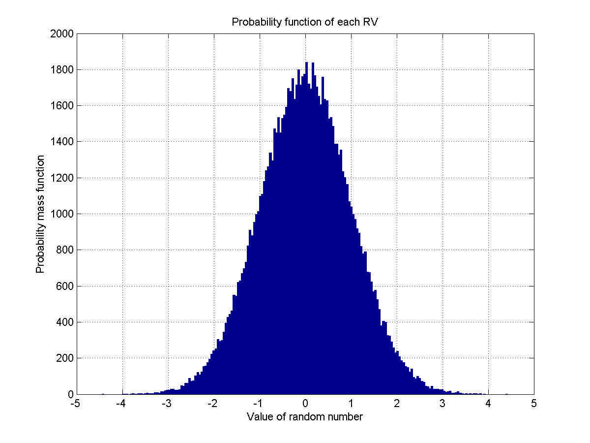
2. Review of Probability Theory: Joint Moments… (12)
Normal distribution μ=0, σ=1

Slide 170
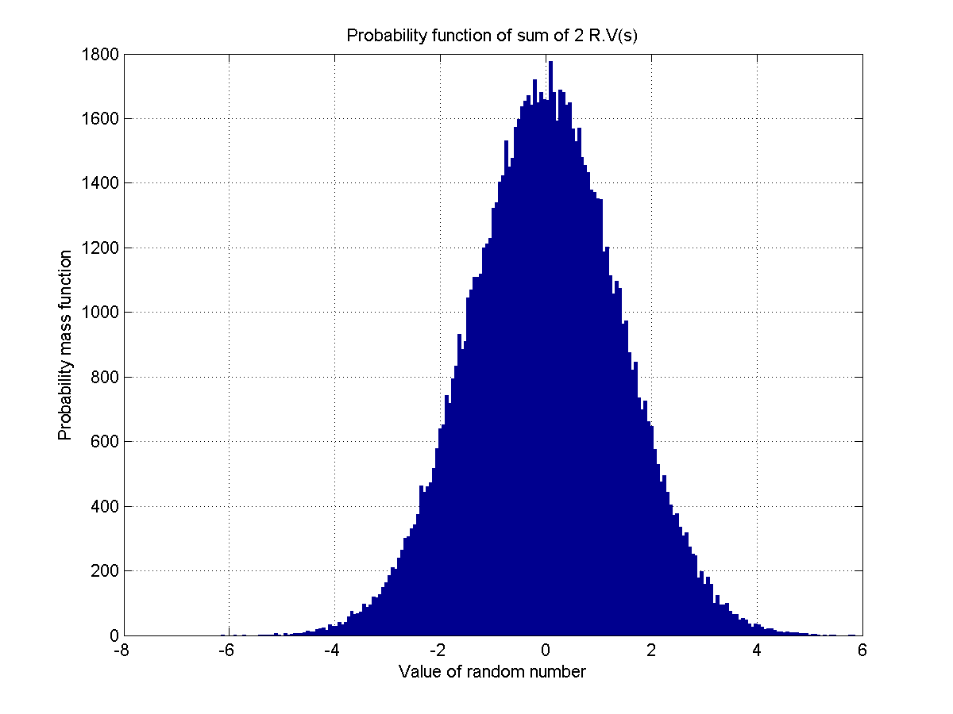
2. Review of Probability Theory: Joint Moments… (13)
Central limit theorem with sum of 2 identically distributed r.vs (normal dis. μ=0,σ=1)

Slide 171

2. Review of Probability Theory: Joint Moments… (14)
Central limit theorem with sum of 1000 identically distributed r.vs (normal dis. μ=0,σ=1)

Slide 172
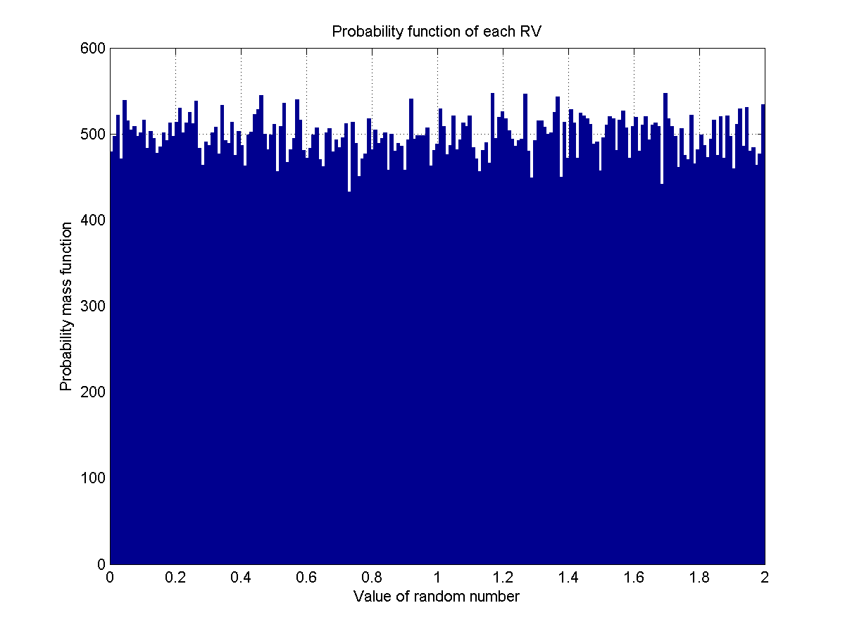
2. Review of Probability Theory: Joint Moments… (15)
Uniform distribution [0, 2]

Slide 173
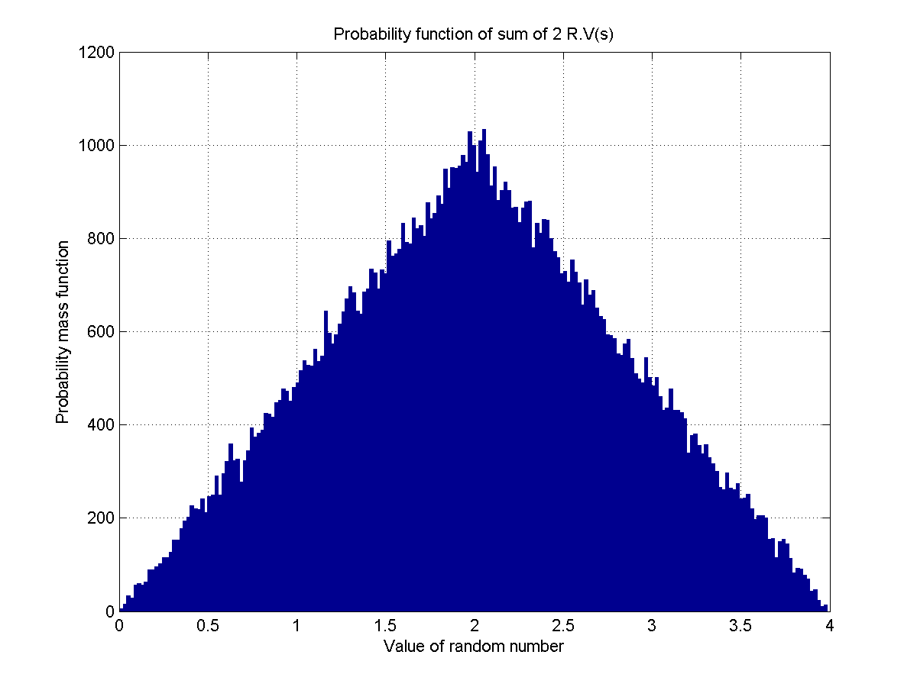
2. Review of Probability Theory: Joint Moments… (16)
Central limit theorem with sum of 2 identically distributed r.vs (uniform dis. [0,2])

Slide 174

2. Review of Probability Theory: Joint Moments… (17)
Central limit theorem with sum of 1000 identically distributed r.vs (uniform dis. [0,2])

Slide 175
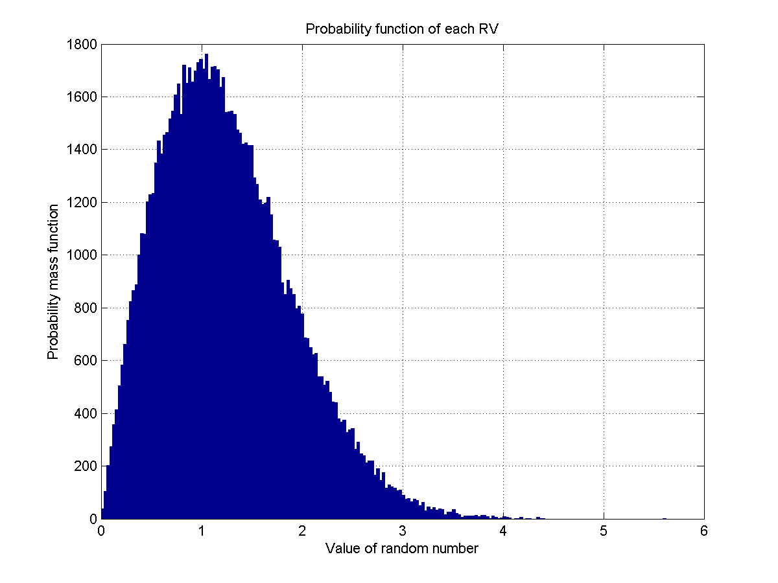
2. Review of Probability Theory: Joint Moments… (18)
Rayleigh distribution, σ=1

Slide 176
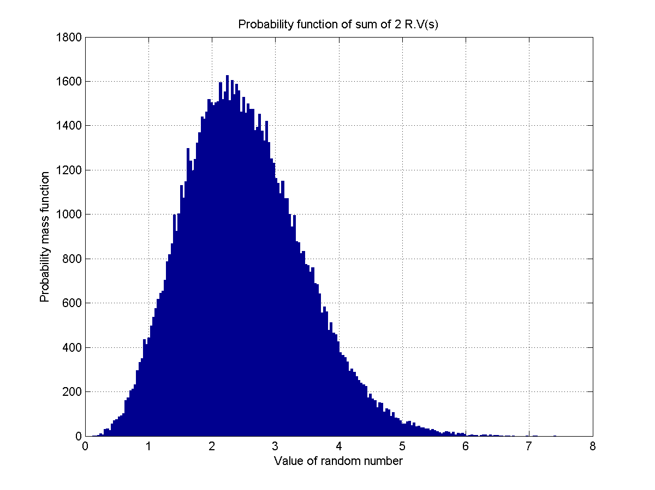
2. Review of Probability Theory: Joint Moments… (19)
Central limit theorem with sum of 2 identically distributed r.vs (Rayleigh dis. ,σ=1)

Slide 177
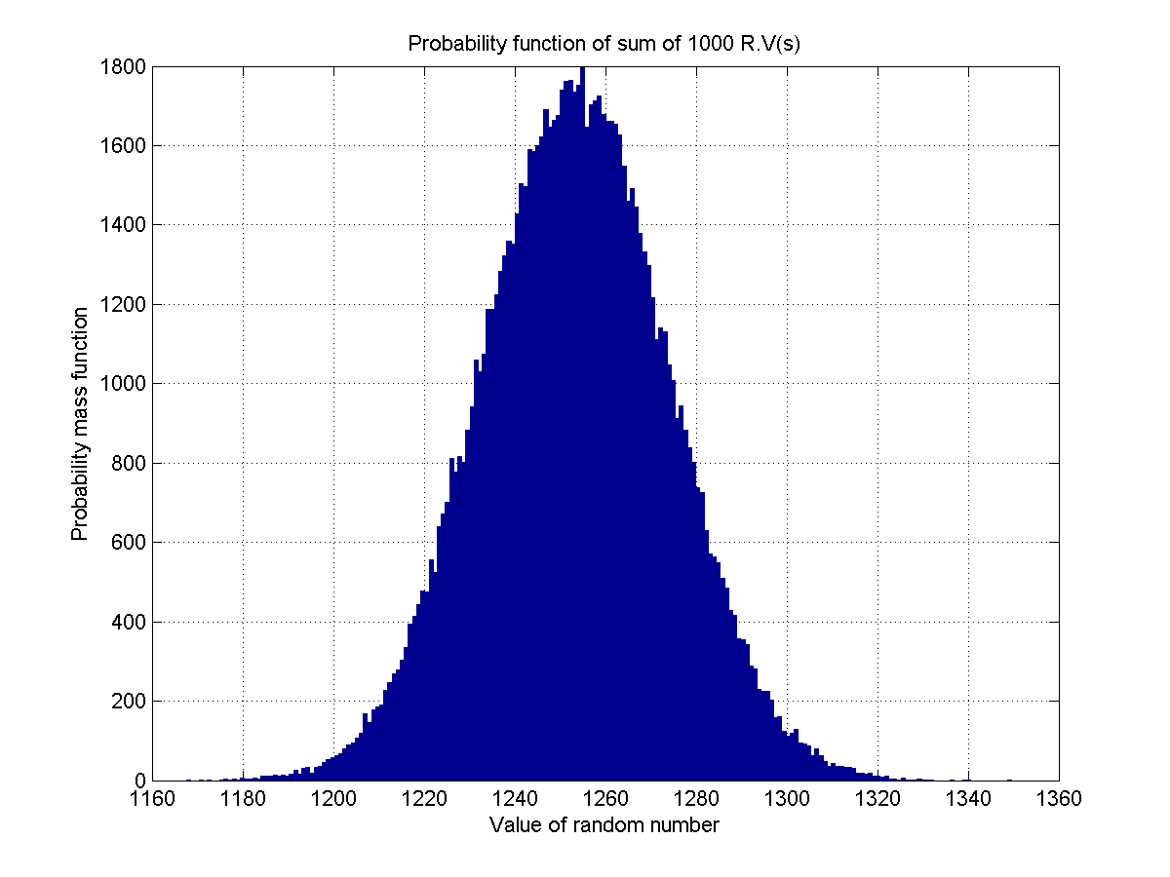
2. Review of Probability Theory: Joint Moments… (20)
Central limit theorem with sum of 1000 identically distributed r.vs (Rayleigh dis. ,σ=1)

Slide 178
2. Review of Stochastic Processes and Models
Mean, Autocorrelation.
Stationarity.
Deterministic Systems.
Discrete Time Stochastic Process.
Stochastic Models.

Slide 179
2. Review of Stochastic Processes: Introduction (1)
Let ζ denote the random outcome of an experiment. To every such
outcome suppose a waveform X(t, ζ) is assigned. The collection of such waveforms form a stochastic process. The set of {ζ_{k}} and the time index t can be continuous or discrete (countably infinite or finite) as well. For fixed ζ_{i} ∈ S (the set of all experimental outcomes), X(t, ζ) is a specific time function. For fixed t, X₁ = X(t₁, ζ_{i}) is a random variable. The ensemble of
all such realizations X(t, ζ) over
time represents the stochastic
process (or random process)
X(t) (see the figure).
For example:
X(t) = acos(ω₀t +φ)
where φ is a uniformly distributed
random variable in (0, 2π),
represents a stochastic process.

Slide 180
2. Review of Stochastic Processes: Introduction (2)
If X(t) is a stochastic process, then for fixed t, X(t) represents a random variable. Its distribution function is given by
Notice that F_{X}(x, t) depends on t, since for a different t, we obtain a different random variable. Further
represents the first-order probability density function of the process X(t).
For t = t₁ and t = t₂, X(t) represents two different random variables
X₁ = X(t₁) and X₂ = X(t₂), respectively. Their joint distribution is given by
and
represents the second-order density function of the process X(t).

Slide 181
2. Review of Stochastic Processes: Introduction (3)
Similarly, f_{X}(x₁, x₂,… x_{n}, t₁, t₂,… t_{n}) represents the nth order density function of the process X(t). Complete specification of the stochastic process X(t) requires the knowledge of f_{X}(x₁, x₂,… x_{n}, t₁, t₂,… t_{n}) for all t_{i} , i = 1, 2…, n and for all n. (an almost impossible task in reality!).
Mean of a stochastic process:
represents the mean value of a process X(t). In general, the mean of
a process can depend on the time index t.
Autocorrelation function of a process X(t) is defined as
and it represents the interrelationship between the random variables
X₁ = X(t₁) and X₂ = X(t₂) generated from the process X(t).

Slide 182
2. Review of Stochastic Processes: Introduction (4)
Properties:
(i)
(Average instantaneous power)
(iii) R_{XX}(t₁, t₂) represents a nonnegative definite function, i.e., for any set of constants {a_{i}}^{n}_{i=1}
this follows by noticing that
The function
represents the autocovariance function of the process X(t).

Slide 183
2. Review of Stochastic Processes: Introduction (5)
Example:
This gives
Similarly,

Slide 184
2. Review of Stochastic Processes: Stationary (1)
Stationary processes exhibit statistical properties that are invariant to
shift in the time index. Thus, for example, second-order stationarity implies that the statistical properties of the pairs {X(t₁) , X(t₂)} and {X(t₁+c),X(t₂+c)}
are the same for any c. Similarly, first-order stationarity implies that the statistical properties of X(t_{i}) and X(t_{i}+c) are the same for any c.
In strict terms, the statistical properties are governed by the joint probability density function. Hence a process is nth-order Strict-Sense Stationary (S.S.S) if
for any c, where the left side represents the joint density function of the random variables X₁ = X(t₁), X₂ = X(t₂), …, X_{n} = X(t_{n}), and the right side corresponds to the joint density function of the random variables X’₁=X(t₁+c), X’₂ = X(t₂+c), …, X’_{n} = X(t_{n}+c). A process X(t) is said to be strict-sense stationary if (*) is true for all t_{i}, i = 1, 2, …, n; n = 1, 2, … and any c.
(*)

Slide 185
2. Review of Stochastic Processes: Stationary (2)
For a first-order strict sense stationary process, from (*) we have
for any c. In particular c = – t gives
i.e., the first-order density of X(t) is independent of t. In that case
Similarly, for a second-order strict-sense stationary process we have from (*)
for any c. For c = – t₂ we get
i.e., the second order density function of a strict sense stationary process depends only on the difference of the time indices t₁ – t₂ = τ .

Slide 186
2. Review of Stochastic Processes: Stationary (3)
In that case the autocorrelation function is given by
i.e., the autocorrelation function of a second order strict-sense stationary
process depends only on the difference of the time indices τ .
However, the basic conditions for the first and second order stationarity are
usually difficult to verify. In that case, we often resort to a looser definition
of stationarity, known as Wide-Sense Stationarity (W.S.S). Thus, a process
X(t) is said to be Wide-Sense Stationary if
(i)
and
(ii)

Slide 187
2. Review of Stochastic Processes: Stationary (4)
i.e., for wide-sense stationary processes, the mean is a constant and the autocorrelation function depends only on the difference between the time indices. Strict-sense stationarity always implies wide-sense stationarity. However, the converse is not true in general, the only exception being the Gaussian process. If X(t) is a Gaussian process, then
wide-sense stationarity (w.s.s) ⇒ strict-sense stationarity (s.s.s).

Slide 188
2. Review of Stochastic Processes: Systems (1)
A deterministic system transforms each input waveform X(t, ζ_{i} ) into an output waveform Y(t, ζ_{i}) = T[X(t, ζ_{i})] by operating only on the time variable t. A stochastic system operates on both the variables t and ζ .
Thus, in deterministic system, a set of realizations at the input corresponding to a process X(t) generates a new set of realizations Y(t, ζ) at the output associated with a new process Y(t).
Our goal is to study the output process statistics in terms of the input
process statistics and the system function.

Slide 189
2. Review of Stochastic Processes: Systems (2)
Deterministic Systems
Memoryless Systems
Systems with Memory
Time-varying
systems
Time-invariant
systems
Linear systems
Linear-Time Invariant
(LTI) systems
LTI system

Slide 190
2. Review of Stochastic Processes: Systems (3)
Memoryless Systems:
The output Y(t) in this case depends only on the present value of the input X(t). i.e.,
Strict-sense
stationary input
Memoryless
system
Strict-sense
stationary output.
Wide-sense
stationary input
Need not be
stationary in
any sense.
Memoryless
system
X(t) stationary
Gaussian with
Memoryless
system
Y(t) stationary,but
not Gaussian with

Slide 191
2. Review of Stochastic Processes: Systems (4)
Theorem: If X(t) is a zero mean stationary Gaussian process, and
Y(t) = g[X(t)], where g(.) represents a nonlinear memoryless device, then
where g’(x) is the derivative with respect to x.
Linear Systems: L[.] represents a linear system if
Let Y(t) = L{X(t)} represent the output of a linear system.
Time-Invariant System: L[.] represents a time-invariant system if
i.e., shift in the input results in the same shift in the output also.
If L[.] satisfies both conditions for linear and time-invariant, then it corresponds to a linear time-invariant (LTI) system.

Slide 192
2. Review of Stochastic Processes: Systems (5)
LTI systems can be uniquely represented in terms of their output to a delta function
then
where
Impulse
response of
the system
LTI
Impulse
Impulse
response
LTI
arbitrary
input

Slide 193
2. Review of Stochastic Processes: Systems (6)
Thus
Then, the mean of the output process is given by
By Linearity
By Time-invariance

Slide 194
2. Review of Stochastic Processes: Systems (7)
Similarly, the cross-correlation function between the input and output
processes is given by

Slide 195
2. Review of Stochastic Processes: Systems (8)
Finally the output autocorrelation function is given by
or
In particular, if X(t) is wide-sense stationary, then we have µ_{X}(t) = µ_{X}
Also

Slide 196
2. Review of Stochastic Processes: Systems (9)
Thus X(t) and Y(t) are jointly w.s.s. Further, the output autocorrelation simplifies to
or

Slide 197
2. Review of Stochastic Processes: Systems (10)
wide-sense
stationary process
LTI system
h(t)
wide-sense
stationary process.
(a)
strict-sense
stationary process
LTI system
h(t)
strict-sense
stationary process
(b)
Linear system
Gaussian process
(also stationary)
Gaussian process
(also stationary)
(c)

Slide 198
2. Review of Stochastic Processes: Systems (11)
White Noise Process: W(t) is said to be a white noise process if
i.e., E[W(t₁) W*(t₂)] = 0 unless t₁ = t₂.
W(t) is said to be wide-sense stationary (w.s.s) white noise if
E[W(t)] = constant, and
If W(t) is also a Gaussian process (white Gaussian process), then all of
its samples are independent random variables (why?).
For w.s.s. white noise input W(t), we have
and
where

Slide 199
2. Review of Stochastic Processes: Systems (12)
Thus the output of a white noise process through an LTI system represents a (colored) noise process.
Note: White noise need not be Gaussian.
“White” and “Gaussian” are two different concepts!
White noise
W(t)
LTI
h(t)

Slide 200
2. Review of Stochastic Processes: Discrete Time (1)
A discrete time stochastic process (DTStP) X_{n} = X(nT) is a sequence of random variables. The mean, autocorrelation and auto-covariance functions of a discrete-time process are gives by
respectively. As before strict sense stationarity and wide-sense stationarity definitions apply here also. For example, X(nT) is wide sense stationary if
and
i.e., R(n₁, n₂) = R(n₁ – n₂) = R*(n₂ – n₁).

Slide 201
2. Review of Stochastic Processes: Discrete Time (2)
If X(nT) represents a wide-sense stationary input to a discrete-time system {h(nT)}, and Y(nT) the system output, then as before the cross correlation function satisfies
and the output autocorrelation function is given by
or
Thus wide-sense stationarity from input to output is preserved for discrete-time systems also.

Slide 202
2. Review of Stochastic Processes: Discrete Time (3)
Mean (or ensemble average μ) of a stochastic process is obtained by
averaging across the process, while time average is obtained by averaging
along the process as
where M is total number of time samples used in estimation.
Consider wide-sense DTStP X_{n}, time average converge to ensemble average
if:
the process X_{n} is said mean ergodic (in the mean-square error sense).

Slide 203
2. Review of Stochastic Processes: Discrete Time (4)
Let define an (M×1)-observation vector x_{n} represents elements of time
series X_{n}, X_{n-1}, ….X_{n-M+1}
x_{n} = [X_{n}, X_{n-1}, ….X_{n-M+1}]^{T}
An (M×M)-correlation matrix R (using condition of wide-sense stationary)
can be defined as
Superscript H denotes Hermitian transposition.

Slide 204
2. Review of Stochastic Processes: Discrete Time (5)
Properties:
(i) Correlation matrix R of stationary DTStP is Hermitian: R^{H} = R or R(k)=R*(k).Therefore:
Matrix R of stationary DTStP is Toeplitz: all elements on main diagonal are equal, elements on any subdiagonal are also equal.
(iii) Let x be arbitrary (nonzero) (M×1)-complex-valued vector, then
x^{H}Rx ≥ 0 (nonnegative definition).
(iv) If x^{B}_{n} is backward arrangement of x_{n}:
Then, E[x^{B}_{n}x^{BH}_{n}] = R^{T}

Slide 205
2. Review of Stochastic Processes: Discrete Time (6)
(v) Consider correlation matrices R_{M} and R_{M+1}, corresponding to M and M+1
observations of process, these matrices are related by
or
where r^{H} = [R(1), R(2),…, R(M)] and r^{BT} = [r(-M), r(-M+1),…, r(-1)]

Slide 206
2. Review of Stochastic Processes: Discrete Time (7)
Consider a time series consisting of complex sine wave plus noise:
Sources of sine wave and noise are independent. Assumed that v(n) has
zero mean and autocorrelation function given by
For a lag k, autocorrelation function of process u(n):

Slide 207
2. Review of Stochastic Processes: Discrete Time (8)
Therefore, correlation matrix of u(n):
where : signal to noise ratio (SNR).

Slide 208
2. Review of Stochastic Models (1)
Consider an input – output representation
where X(n) may be considered as the output of a system {h(n)} driven by the input W(n). Using z – transform, it gives
or
represents the transfer function of the associated system response {h(n)} so that
W(n)
h(n)
X(n)

Slide 209
2. Review of Stochastic Models (2)
Notice that the transfer function H(z) is rational with p poles and q zeros that determine the model order of the underlying system. The output X(n) undergoes regression over p of its previous values and at the same time a moving average based on W(n), W(n-1), …, W(n-q) of the input over (q + 1) values is added to it, thus generating an Auto Regressive Moving Average (ARMA (p, q)) process X(n).
Generally the input {W(n)} represents a sequence of uncorrelated random variables of zero mean and constant variance so that
If in addition, {W(n)} is normally distributed then the output {X(n)} also represents a strict-sense stationary normal process.
If q = 0, then X(n) represents an Auto Regressive AR(p) process (all-pole
process), and if p = 0, then X(n) represents an Moving Average MA(q) process (all-zero process).

Slide 210
2. Review of Stochastic Models (3)
AR(1) process: An AR(1) process has the form
and the corresponding system transfer function
provided | a | < 1. Thus
represents the impulse response of an AR(1) stable system. We get the output autocorrelation sequence of an AR(1) process to be
The normalized (in terms of R_{XX} (0)) output autocorrelation sequence is
given by

Slide 211
2. Review of Stochastic Models (4)
It is instructive to compare an AR(1) model discussed above by superimposing a random component to it, which may be an error term associated with observing a first order AR process X(n). Thus
where X(n) ~ AR(1), and V(n) is an uncorrelated random sequence with zero mean and variance σ²_{V} that is also uncorrelated with {W(n)}. Then, we obtain the output autocorrelation of the observed process Y(n) to be
so that its normalized version is given by
where

Slide 212
2. Review of Stochastic Models (5)
The results demonstrate the effect of superimposing an error sequence on
an AR(1) model. For non-zero lags, the autocorrelation of the observed
sequence {Y(n)} is reduced by a constant factor compared to the original
process {X(n)}. The superimposed error sequence V(n) only affects the
corresponding term in Y(n) (term by term). However, a particular term in
the “input sequence” W(n) affects X(n) and Y(n) as well as all subsequent
observations.

Slide 213
2. Review of Stochastic Models (6)
AR(2) Process: An AR(2) process has the form
and the corresponding transfer function is given by
so that
and in term of the poles of the transfer function, we have
that represents the impulse response of the system. We also have
and H(z) stable implies

Slide 214
2. Review of Stochastic Models (7)
Further, the output autocorrelations satisfy the recursion
and hence their normalized version is given by
By direct calculation using, the output autocorrelations are given by

Slide 215
2. Review of Stochastic Models (8)
Then, the normalized output autocorrelations may be expressed as

Slide 216
2. Review of Stochastic Models (9)
An ARMA (p, q) system has only p + q + 1 independent coefficients,
(a_{k}, k = 1… p; b_{i}, i = 0… q) and hence its impulse response sequence {h_{k}}
also must exhibit a similar dependence among them. In fact, according to
P. Dienes (1931), and Kronecker (1881) states that the necessary and
sufficient condition for to represent a rational system
(ARMA) is that
where
i.e., in the case of rational systems for all sufficiently large n, the Hankel
matrices H_{n} all have the same rank.

